Slide 1
Ferrometal Industrial Group
Brief business report about Ferrometal during 25 years of experience.
Ferrometal Industrial Group
Velazquez,Str., 94, 1st floor, E, 28006 Madrid – Spain
Phone : +34 602616324 // Office number 914009610
Mobile: +34 603286792
email: info@ferrometalgroup.com / man_cornelia@hotmail.com
Web Office : www. ferrometalgroup.com
0

Slide 2
Ferrometal IG S.L. is a professional industrial company with more than 52 years of experience.
Ferrometal IG SL is a familiar company. It is the parent company of many other companies: Ferrometal Scrap Naval, Ferrometal group. etc, which only managing director and owner is Mrs. Cornelia Man.
Ferrometal IG SL had been wholesale exporter around the world for ferrous ,non-ferrous metals , and scrap metals for more than 25 years, with a annual turnover of 350 to 400 million dollars, selling more than 1million ton of ferrous and non-ferrous metals.
Ferrometal IG SL bought metals (iron and steel ) directly from manufacturers from Russia, Bulgaria, Ukraine and Romania and sold it to companies all over the world including Indian companies, such as Arcelor Mittal, metal steel, Raj auto India…

Slide 3
Also, Ferrometal IG SL sold petroleum from Saudi Arabia and sold it to the Nordic countries. Ferrometal IG sold more than 350 million of oil barrels from Saudi Aramco.
Ferrometal IG SL sponsored all types of industrial conferences and events in Dubai, Norway, Denmark…
In 2009, Ferrometal IG SL. has acquired a unique high-tech patent about ships dismantling and recycling plant, which gives a worldwide solution for problems linked to abandoned vessels.
This technology has the capacity to recycle all kind of ships through a non-contamination process.

Slide 4
Relevant Statements
“The main goal of the EC strategy is to guarantee that the ship scrapping process should be safe and and eco friendly”.
European Commission (EC)
Environmental Protection Agency (EPA)
Oil Pollution Act (OPA 90) –“Between 2010 and 2015 single-hull oil tankers should be removed entirely”.
MARPOL (International Convention for the Prevention of Pollution From Ships) – “Since single hull tankers are impossible to adapt to double hull tankers, they should be removed from the seas (discarded)”.
International Maritime Organization (IMO)
3

Slide 5
Advantages of the dismantling plant implementation
First scrapping plant with no physical risk for workers.
First technology that offers solutions of the requests from different agencies cited previously.
Profitable project that guarantee a convenient time of return on investment.
This project will create 5.000 jobs.
This project could be developed anywhere around the world, As long as 105 Ha of land, with coast entry and 10 meters of depth can be obtained.
A large number of abandoned vessels (that reaches 16 billion Metric Tones) opens a significant opportunity.
4

Slide 6
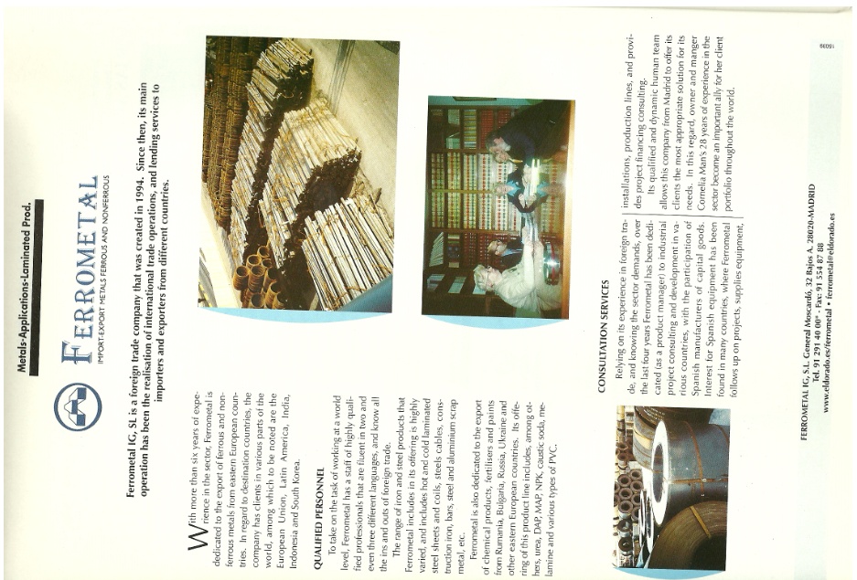

Slide 7
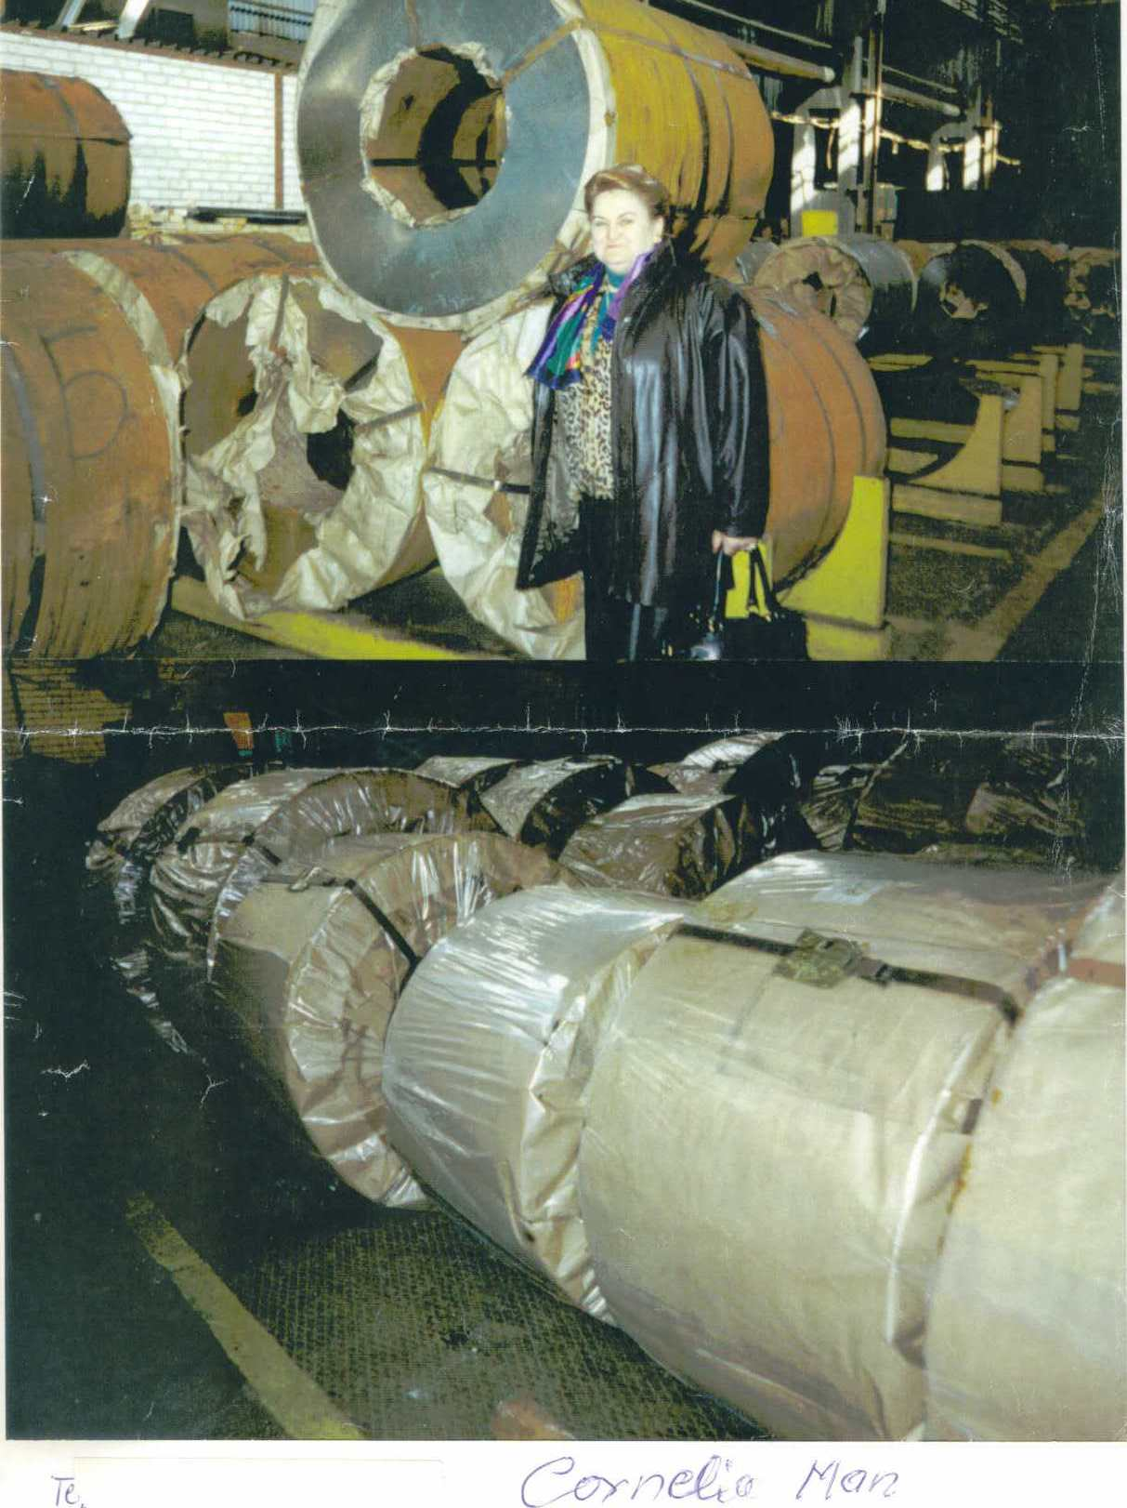
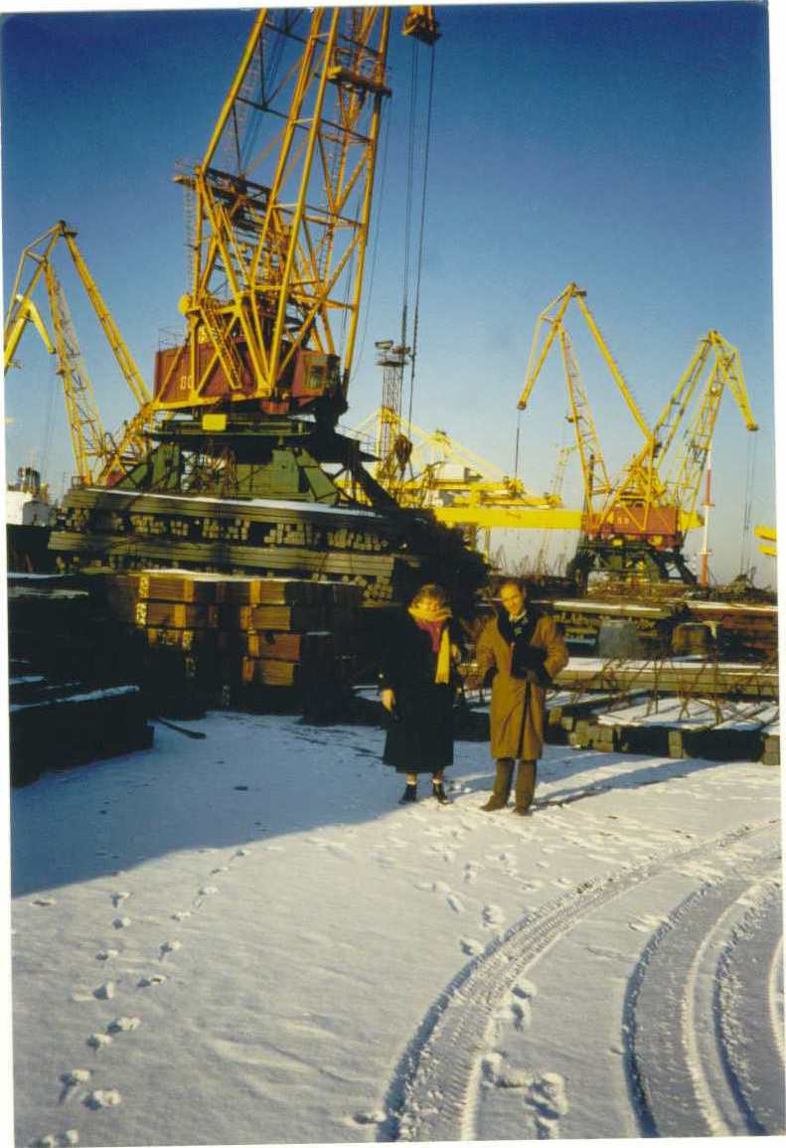

Slide 8
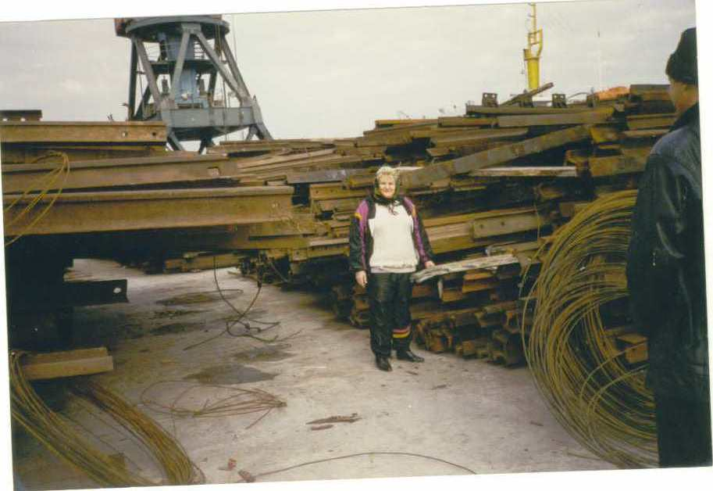
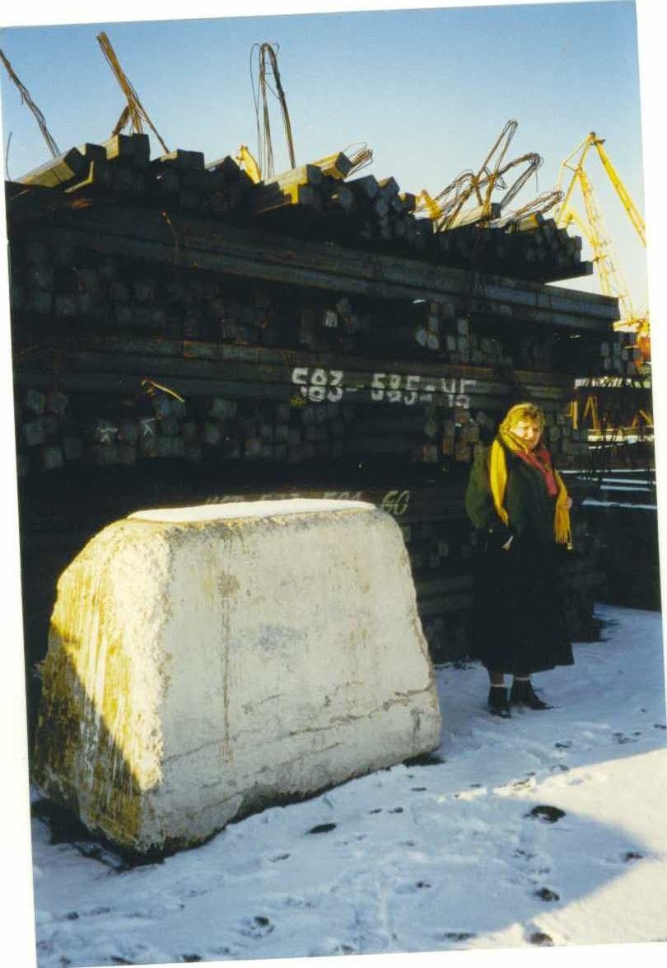
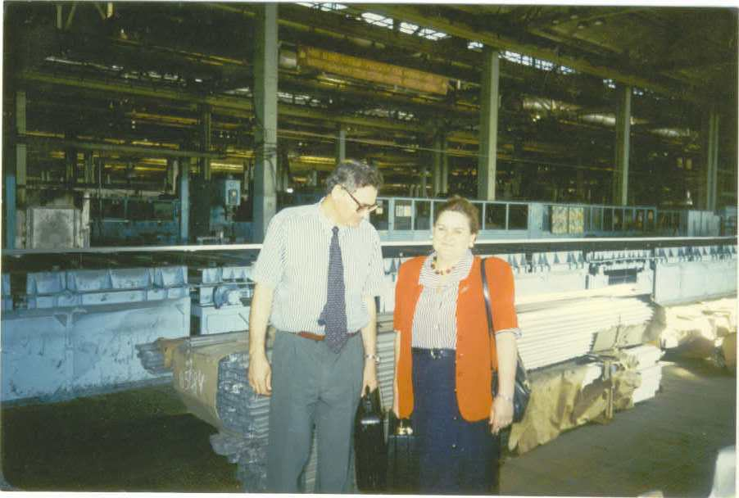

Slide 9
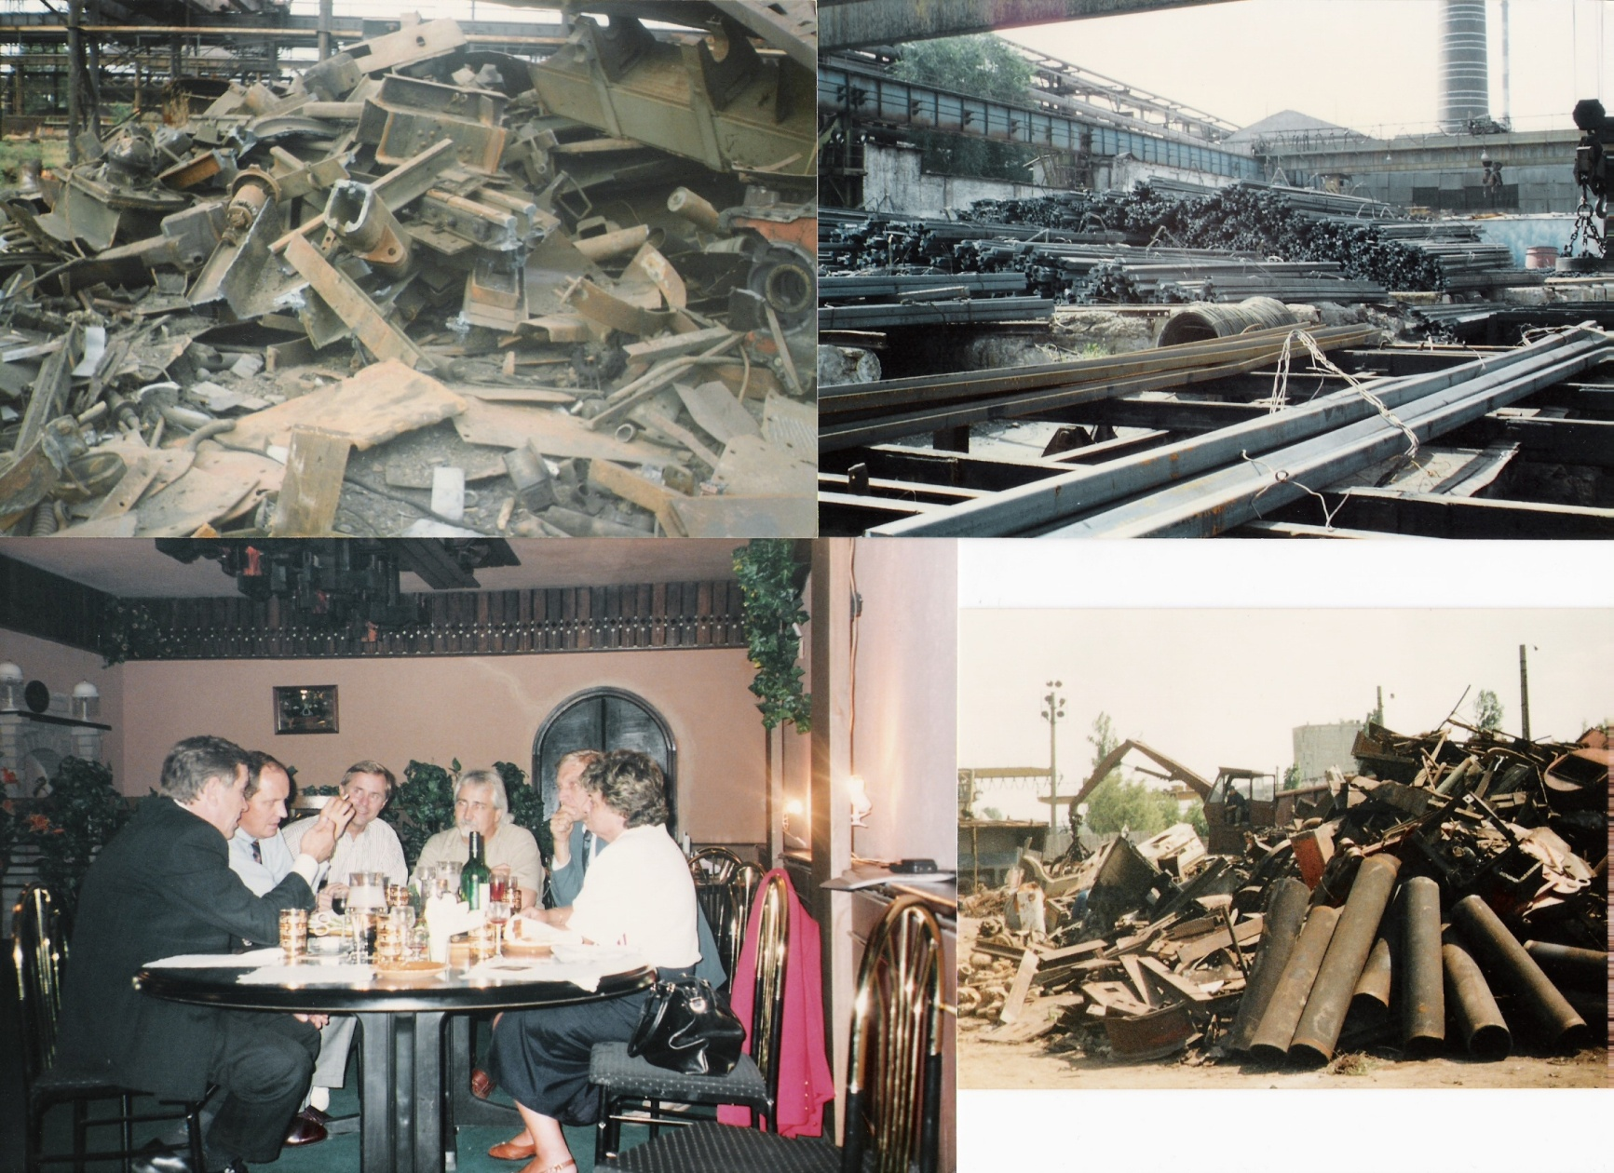

Slide 10
Ship Graveyard in Nouadhibou-Mauritania
9

Slide 11
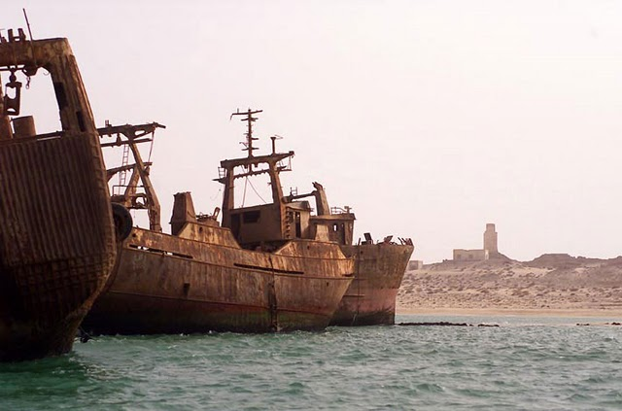
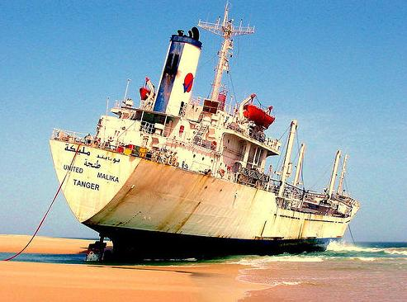
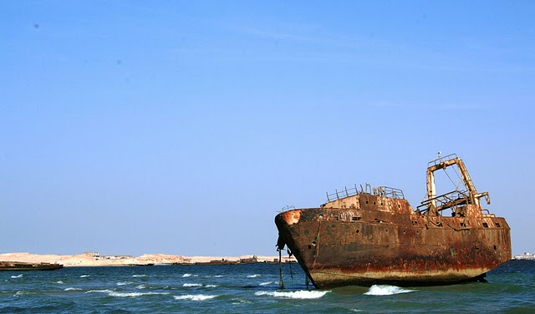
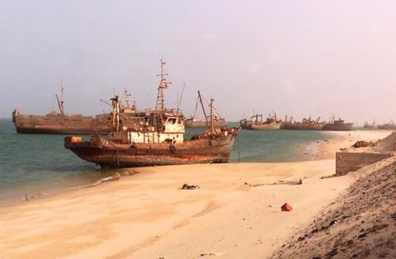
Ship Graveyard (Nouadhibou-Mauritania)

Slide 12


Slide 13
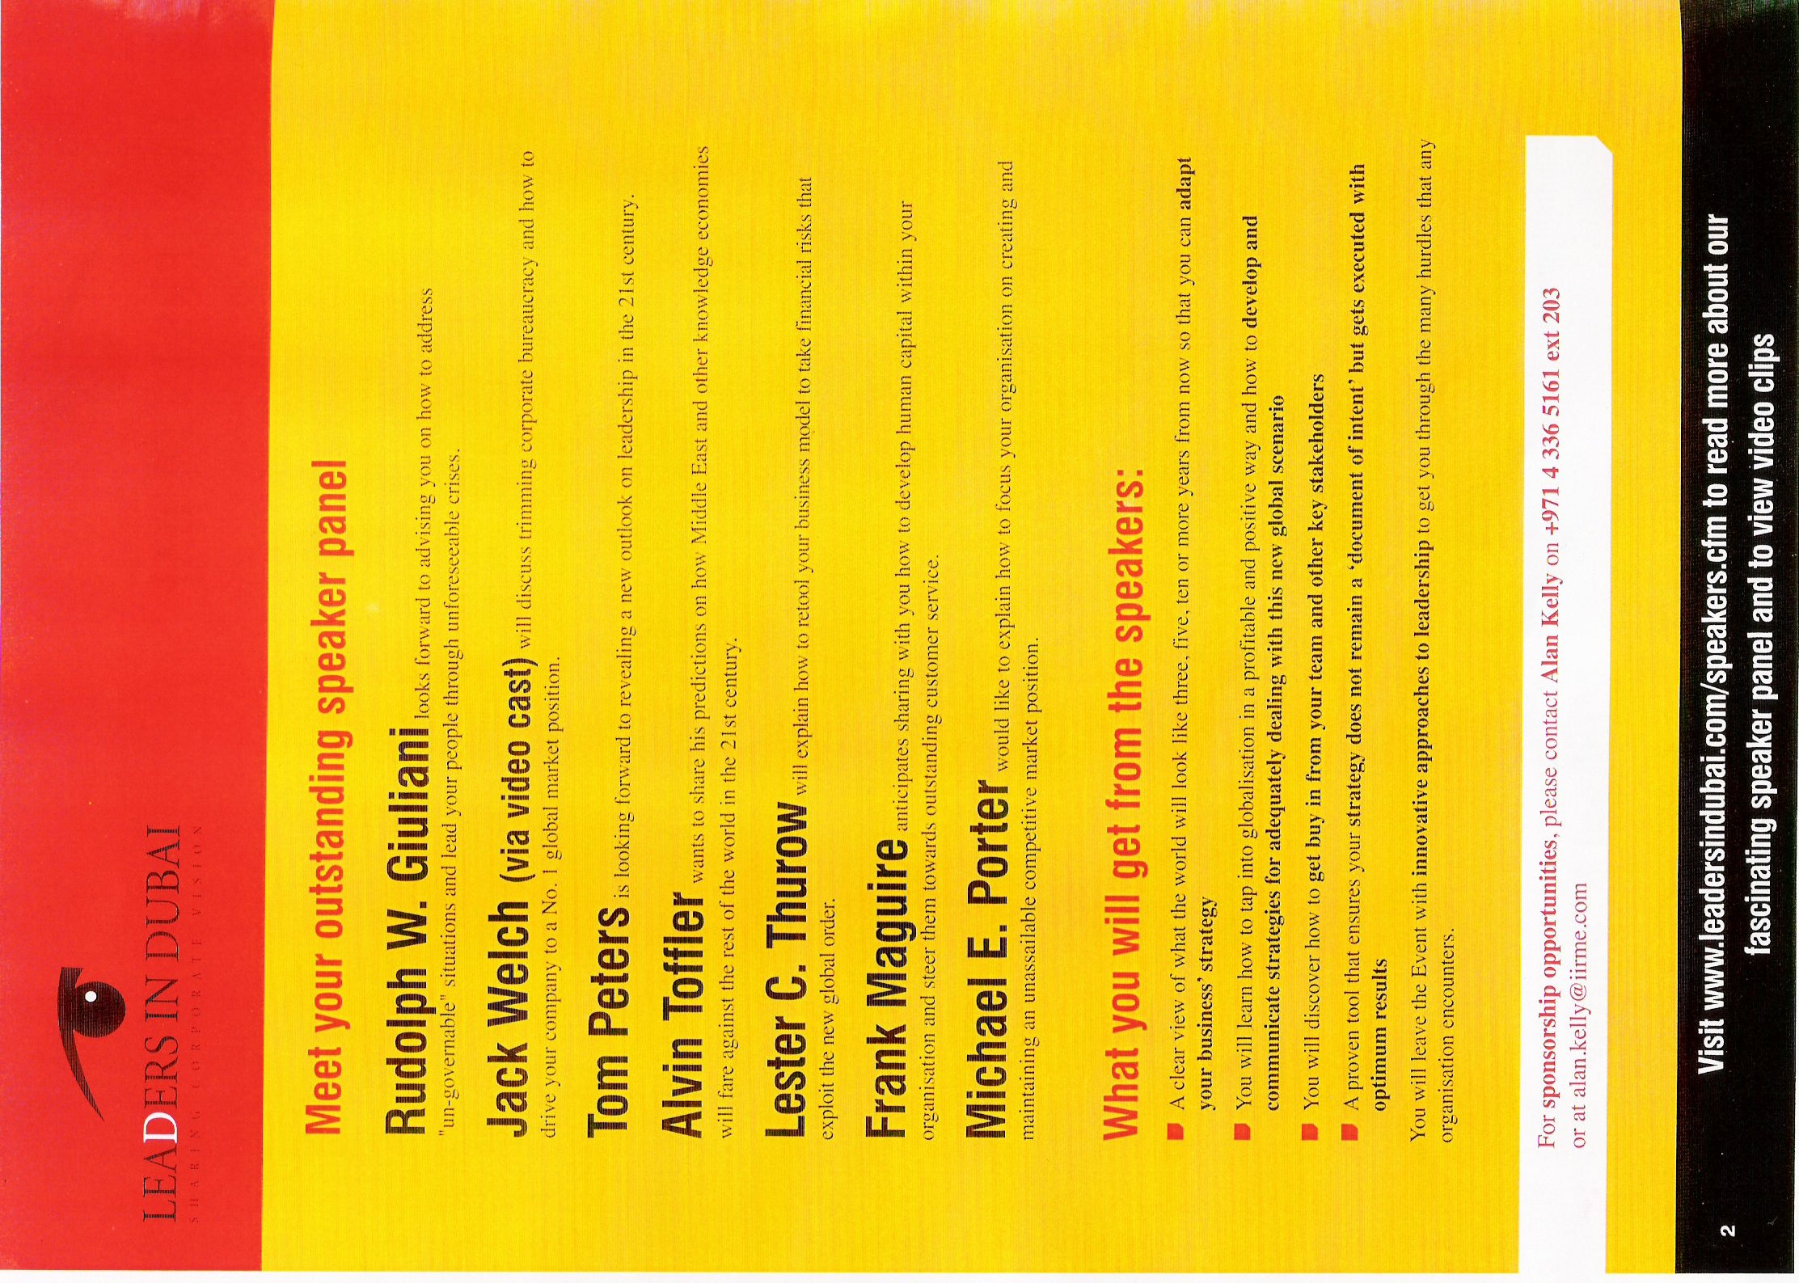

Slide 14
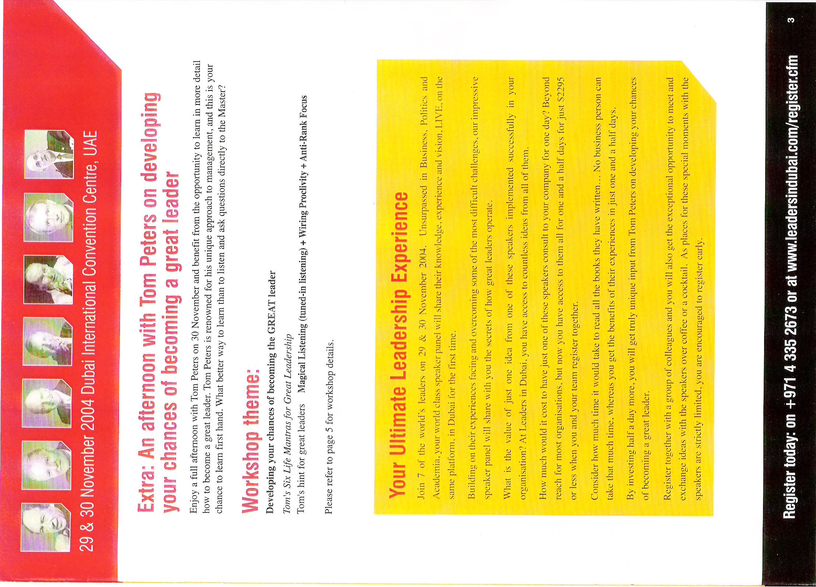

Slide 15
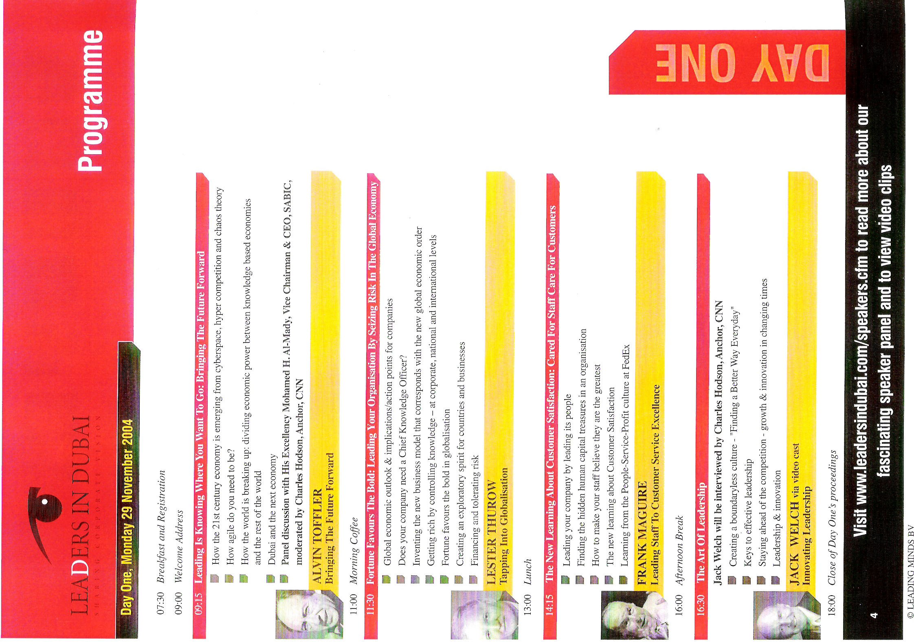

Slide 16
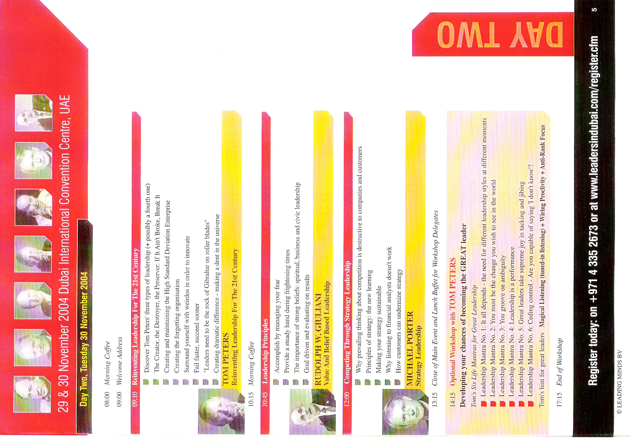

Slide 17
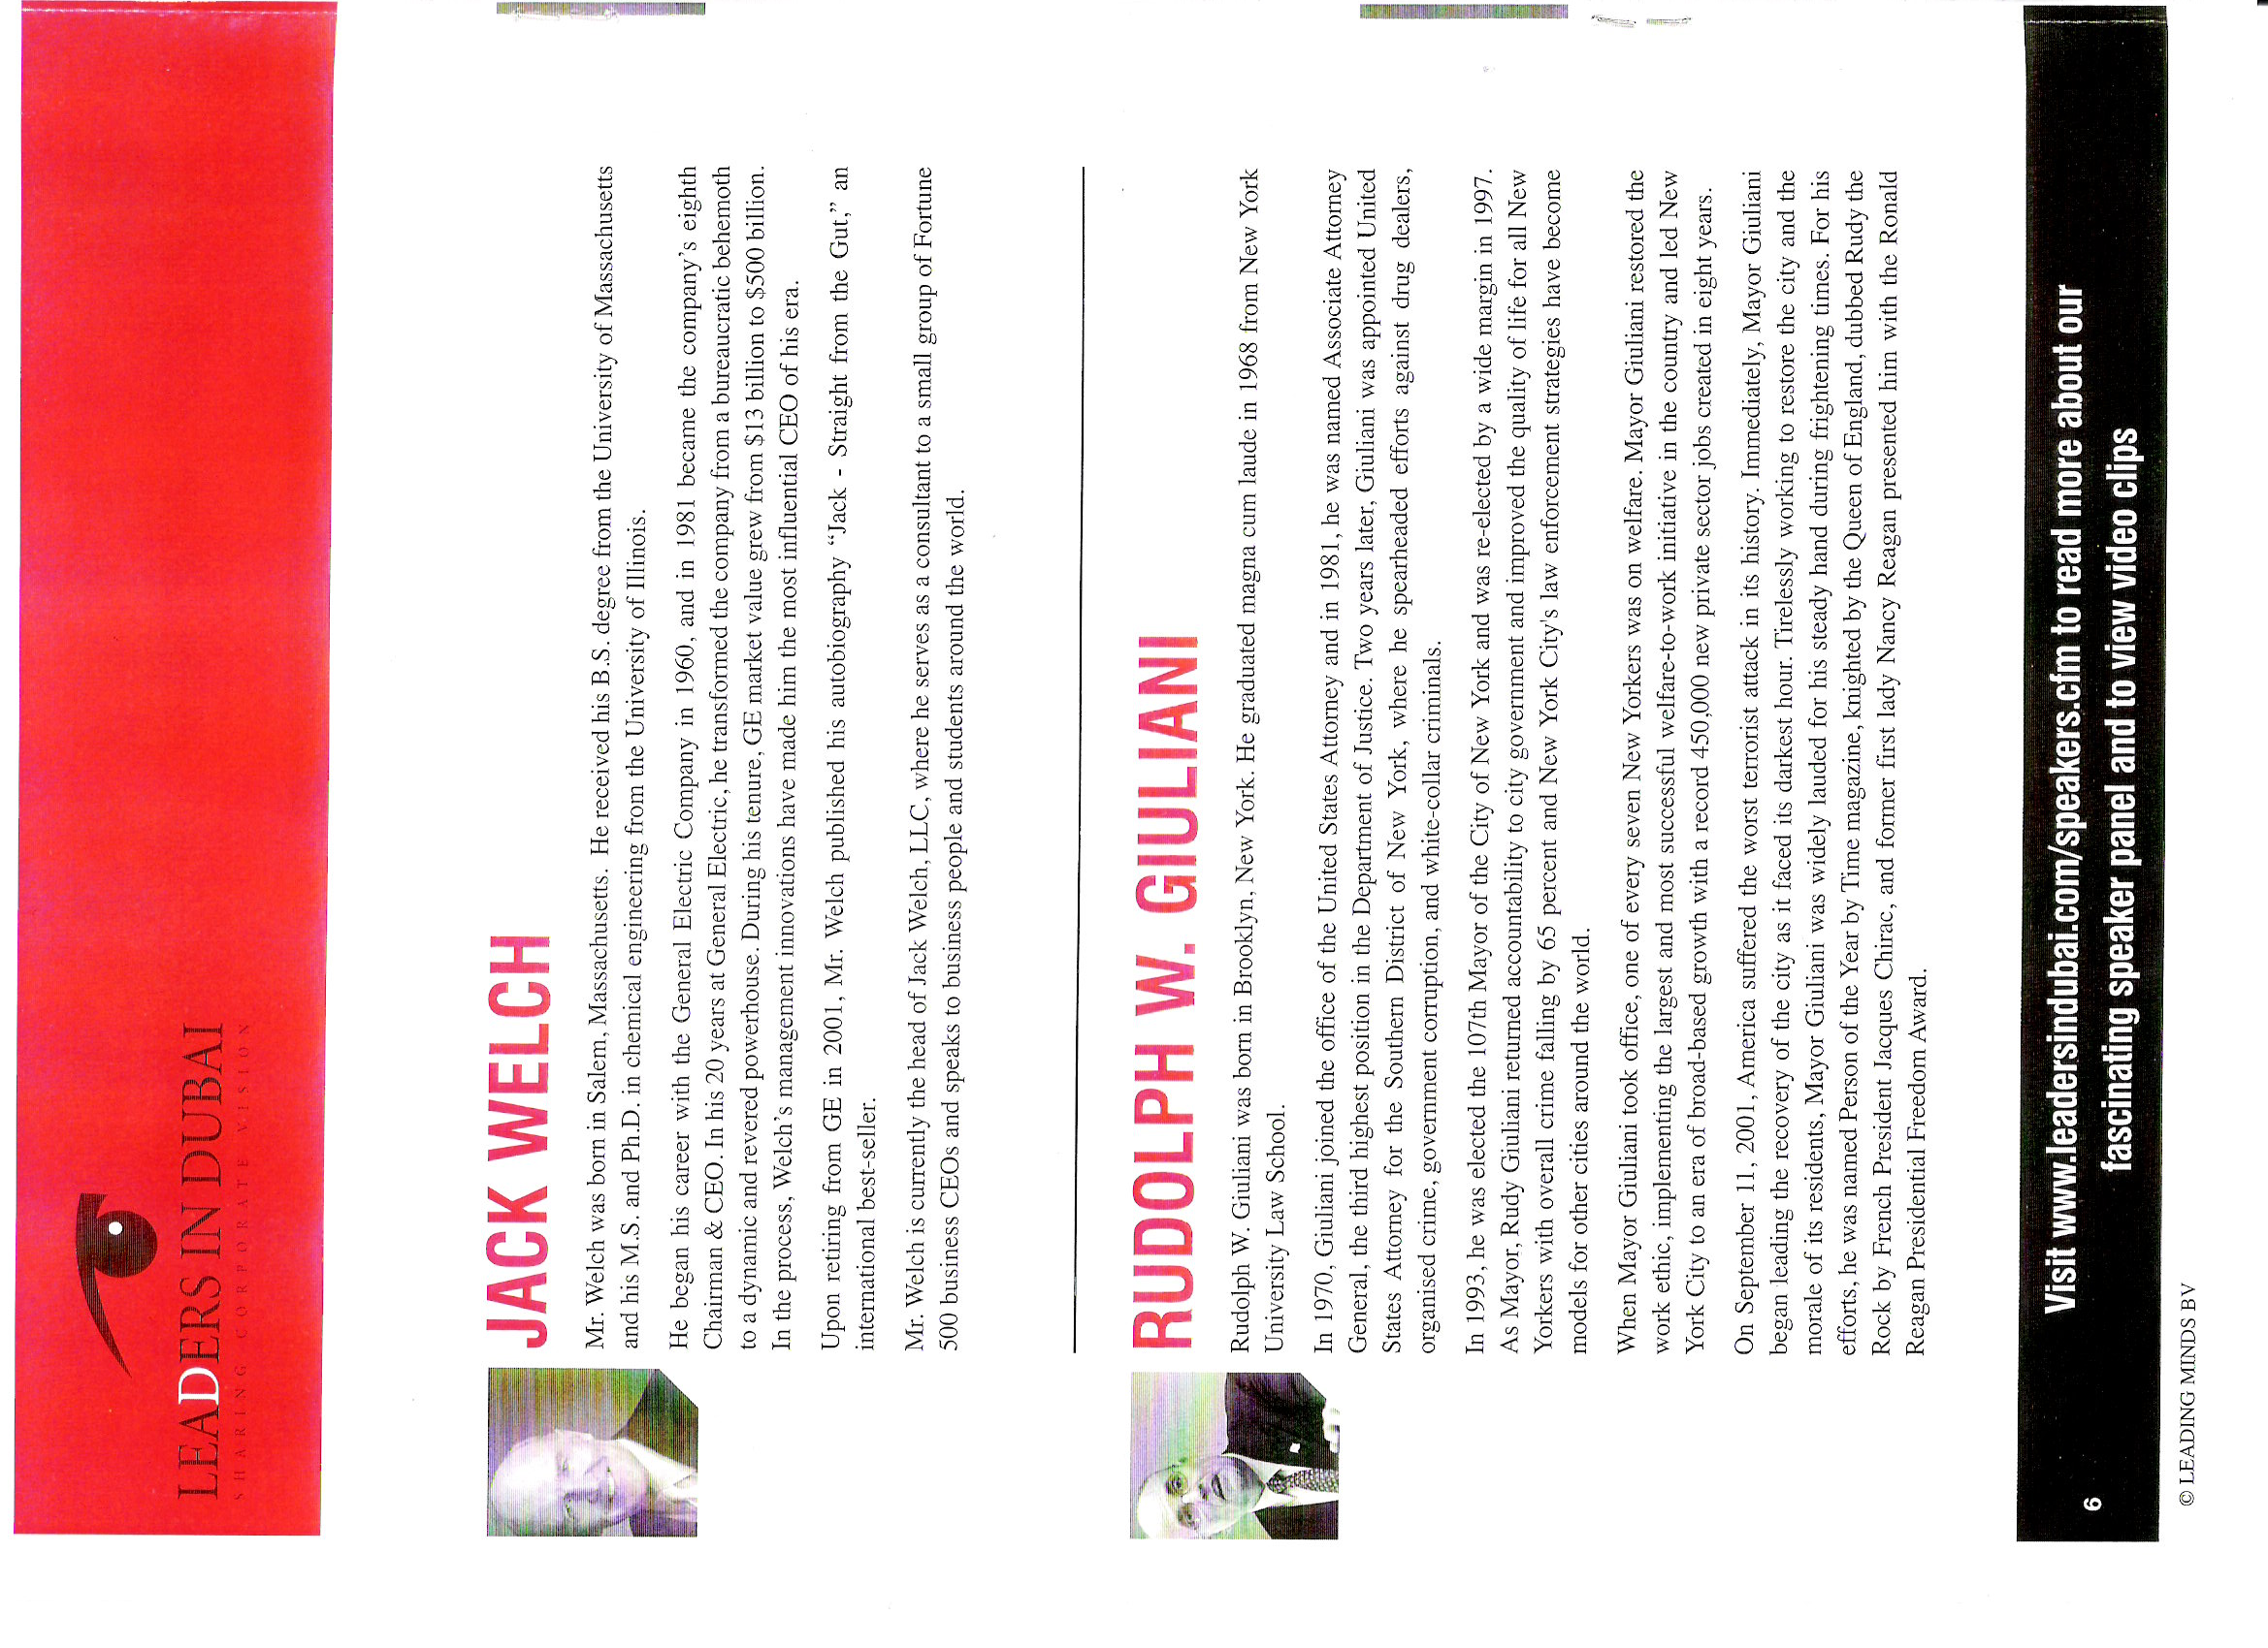

Slide 18
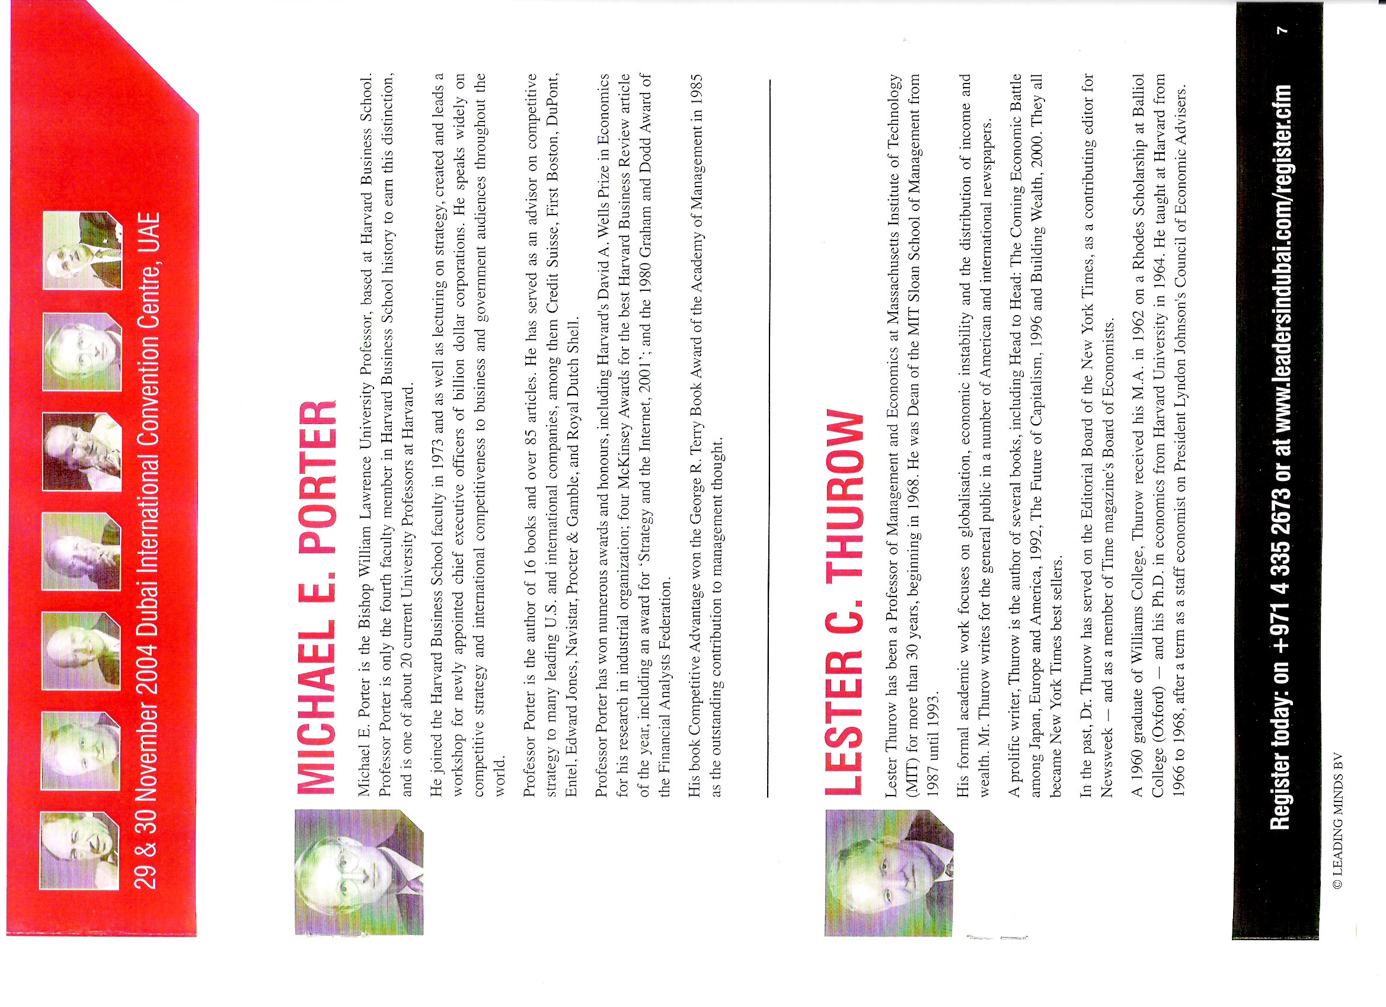

Slide 19
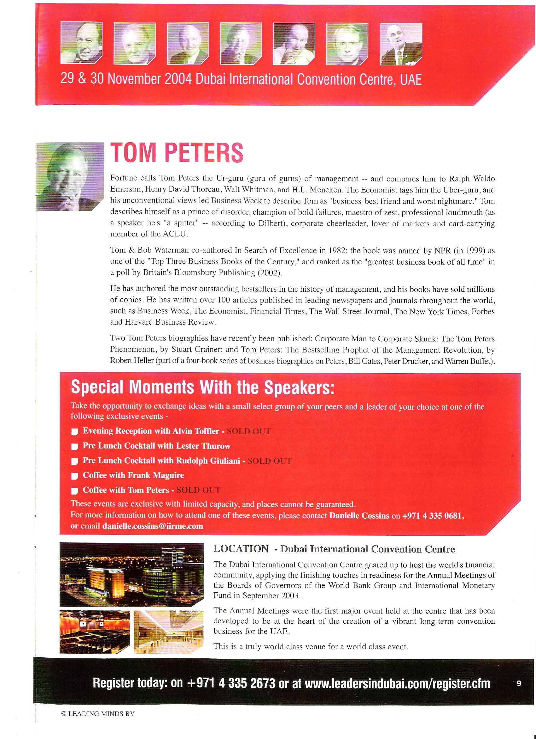
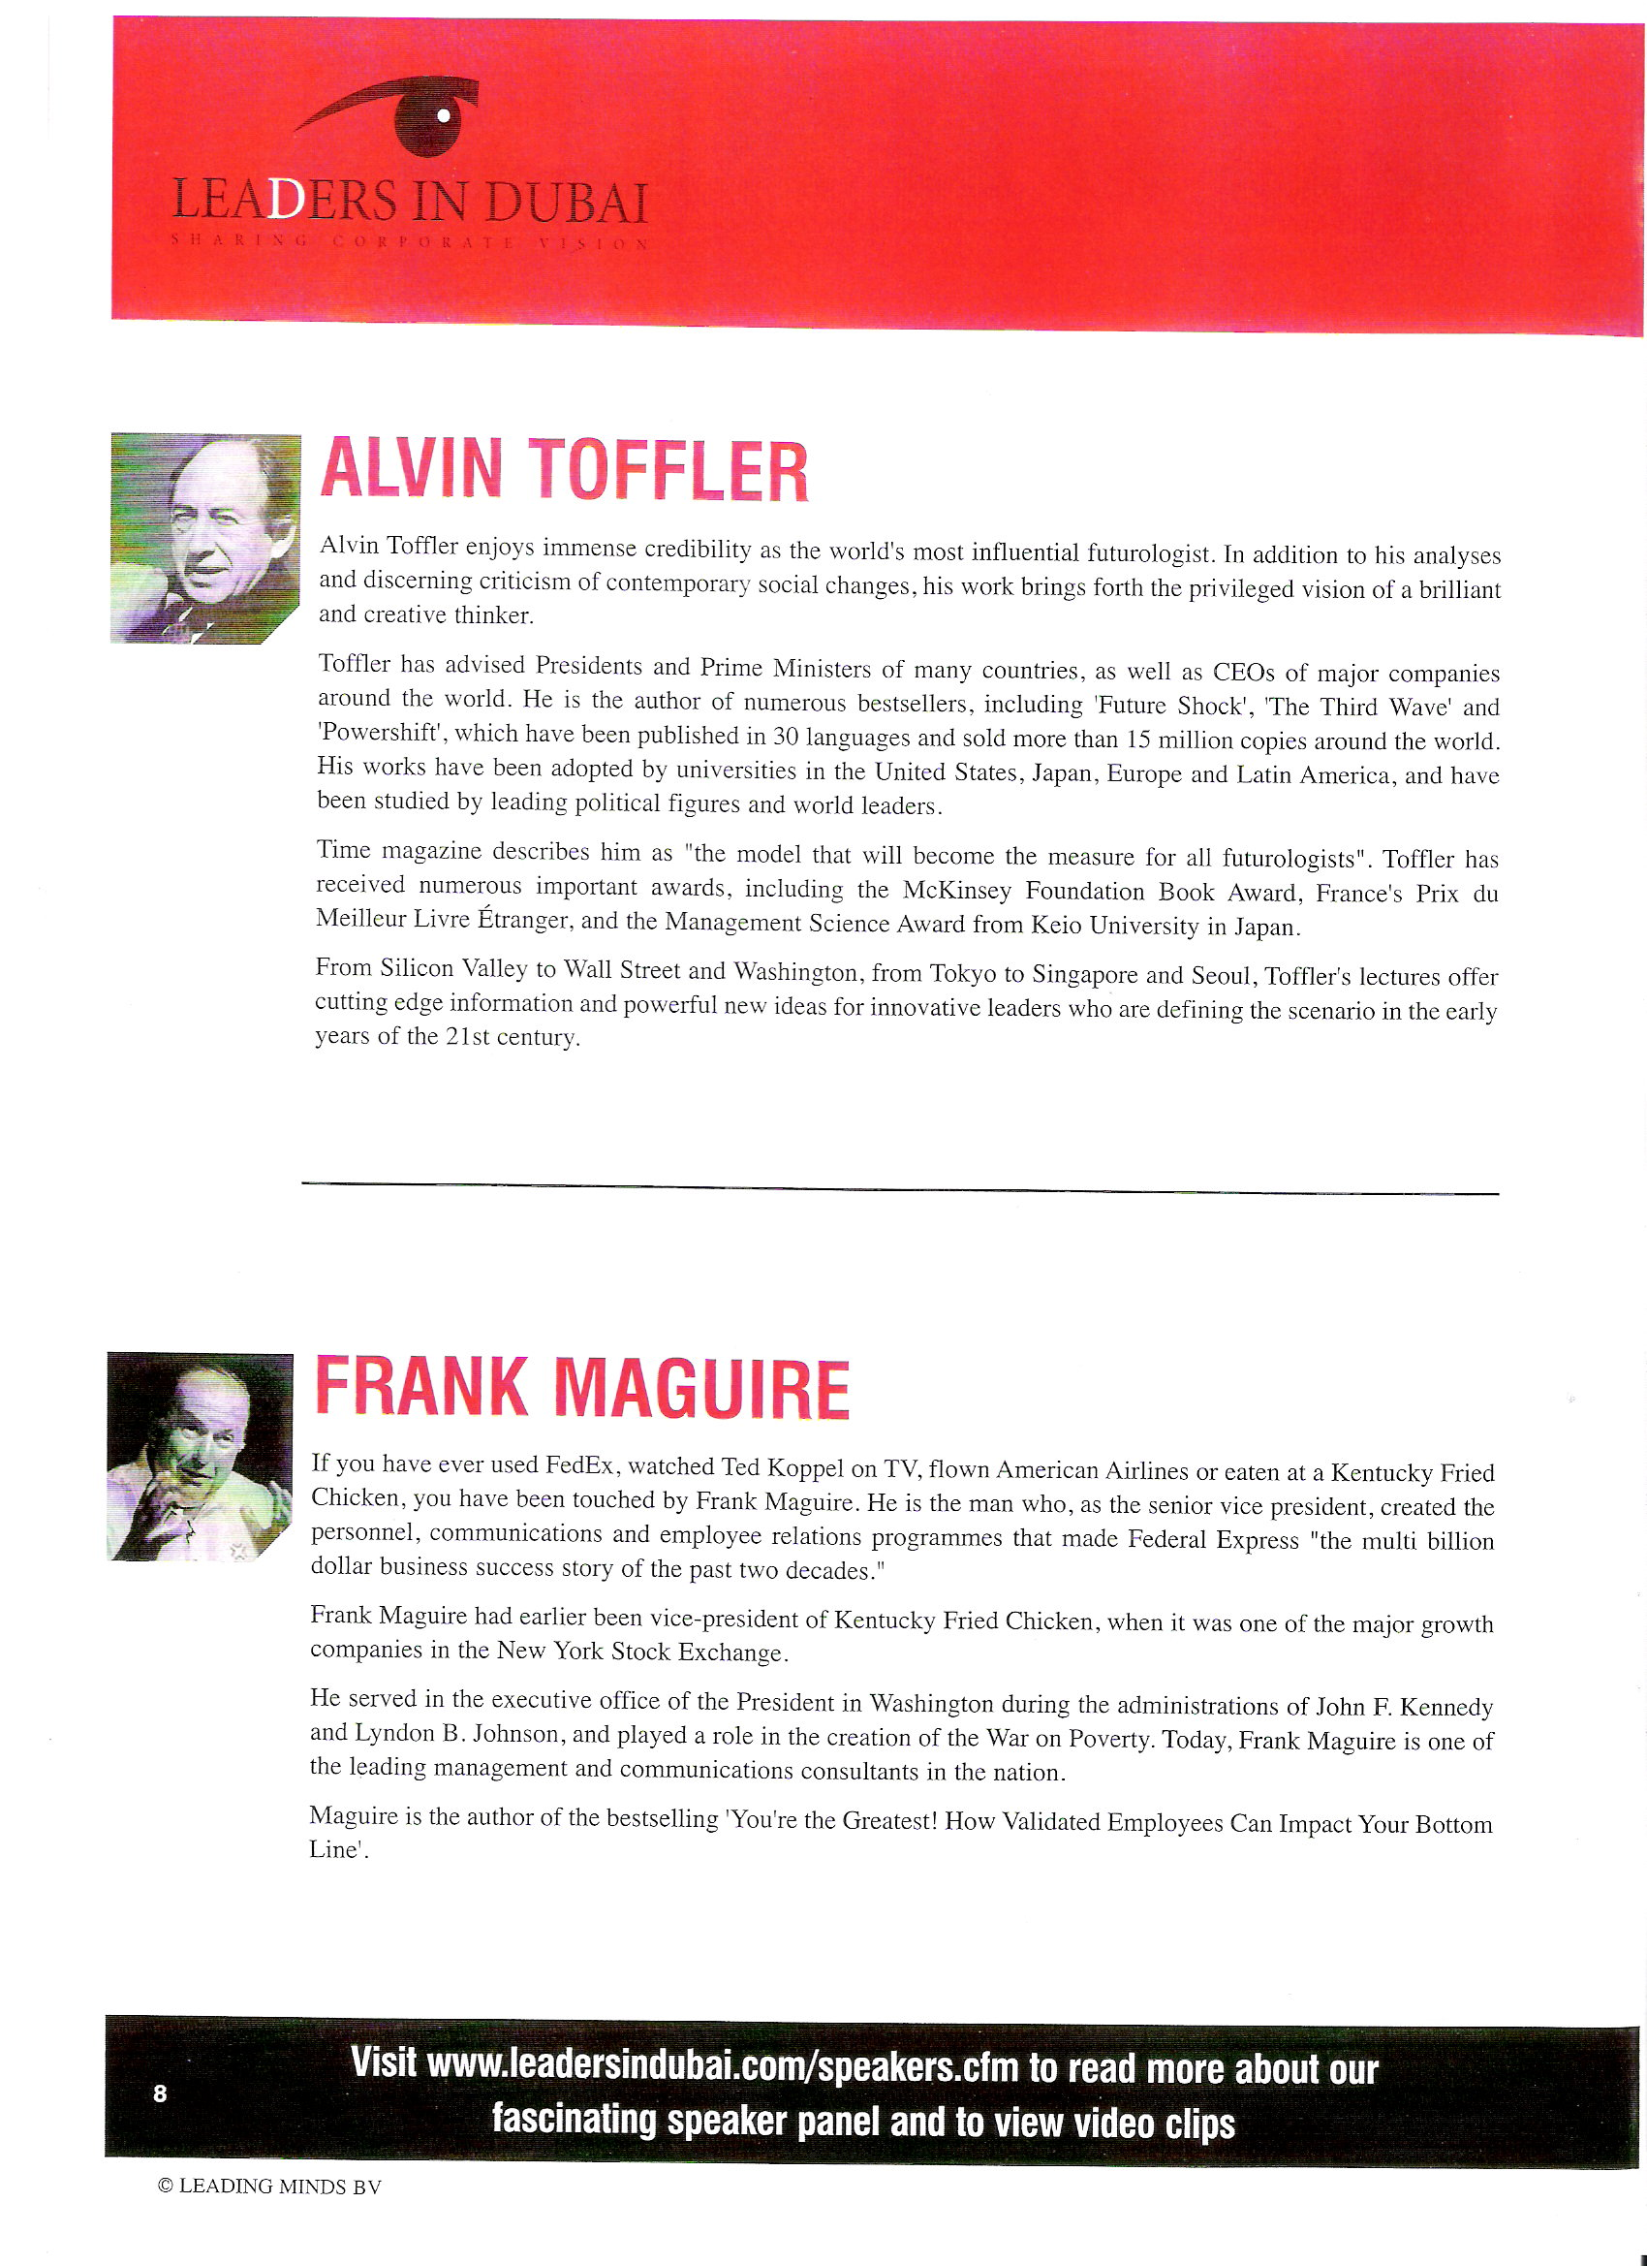

Slide 21
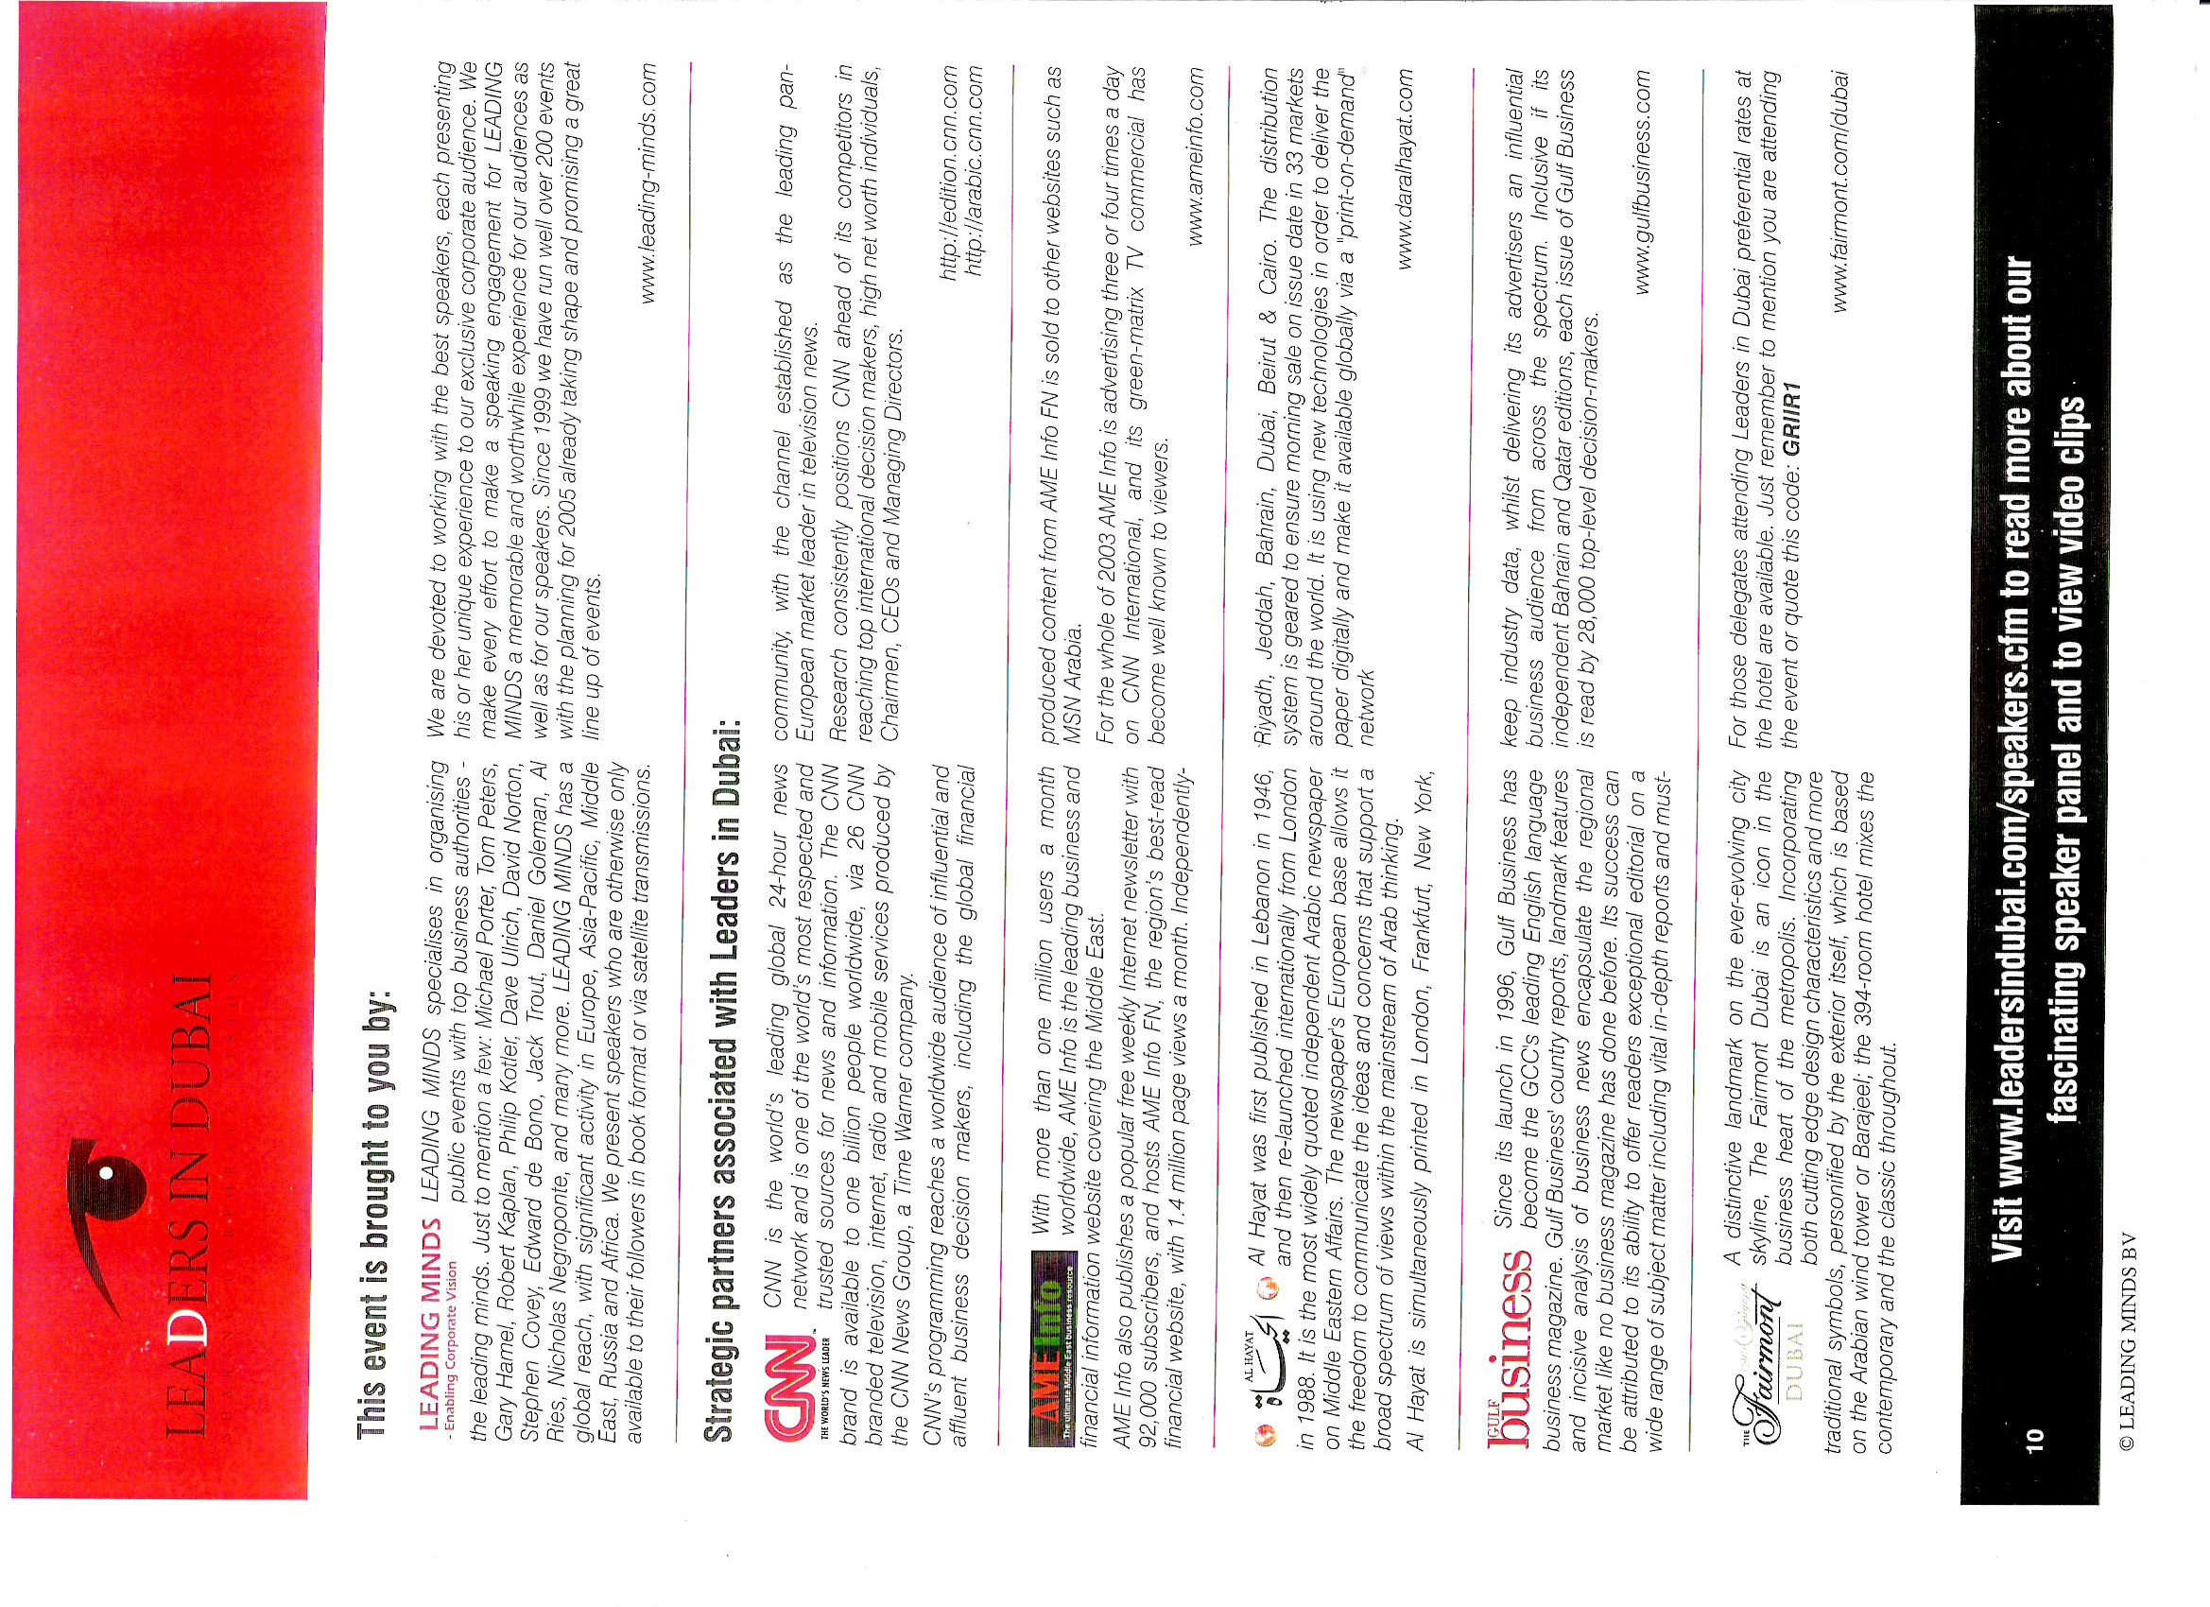

Slide 22
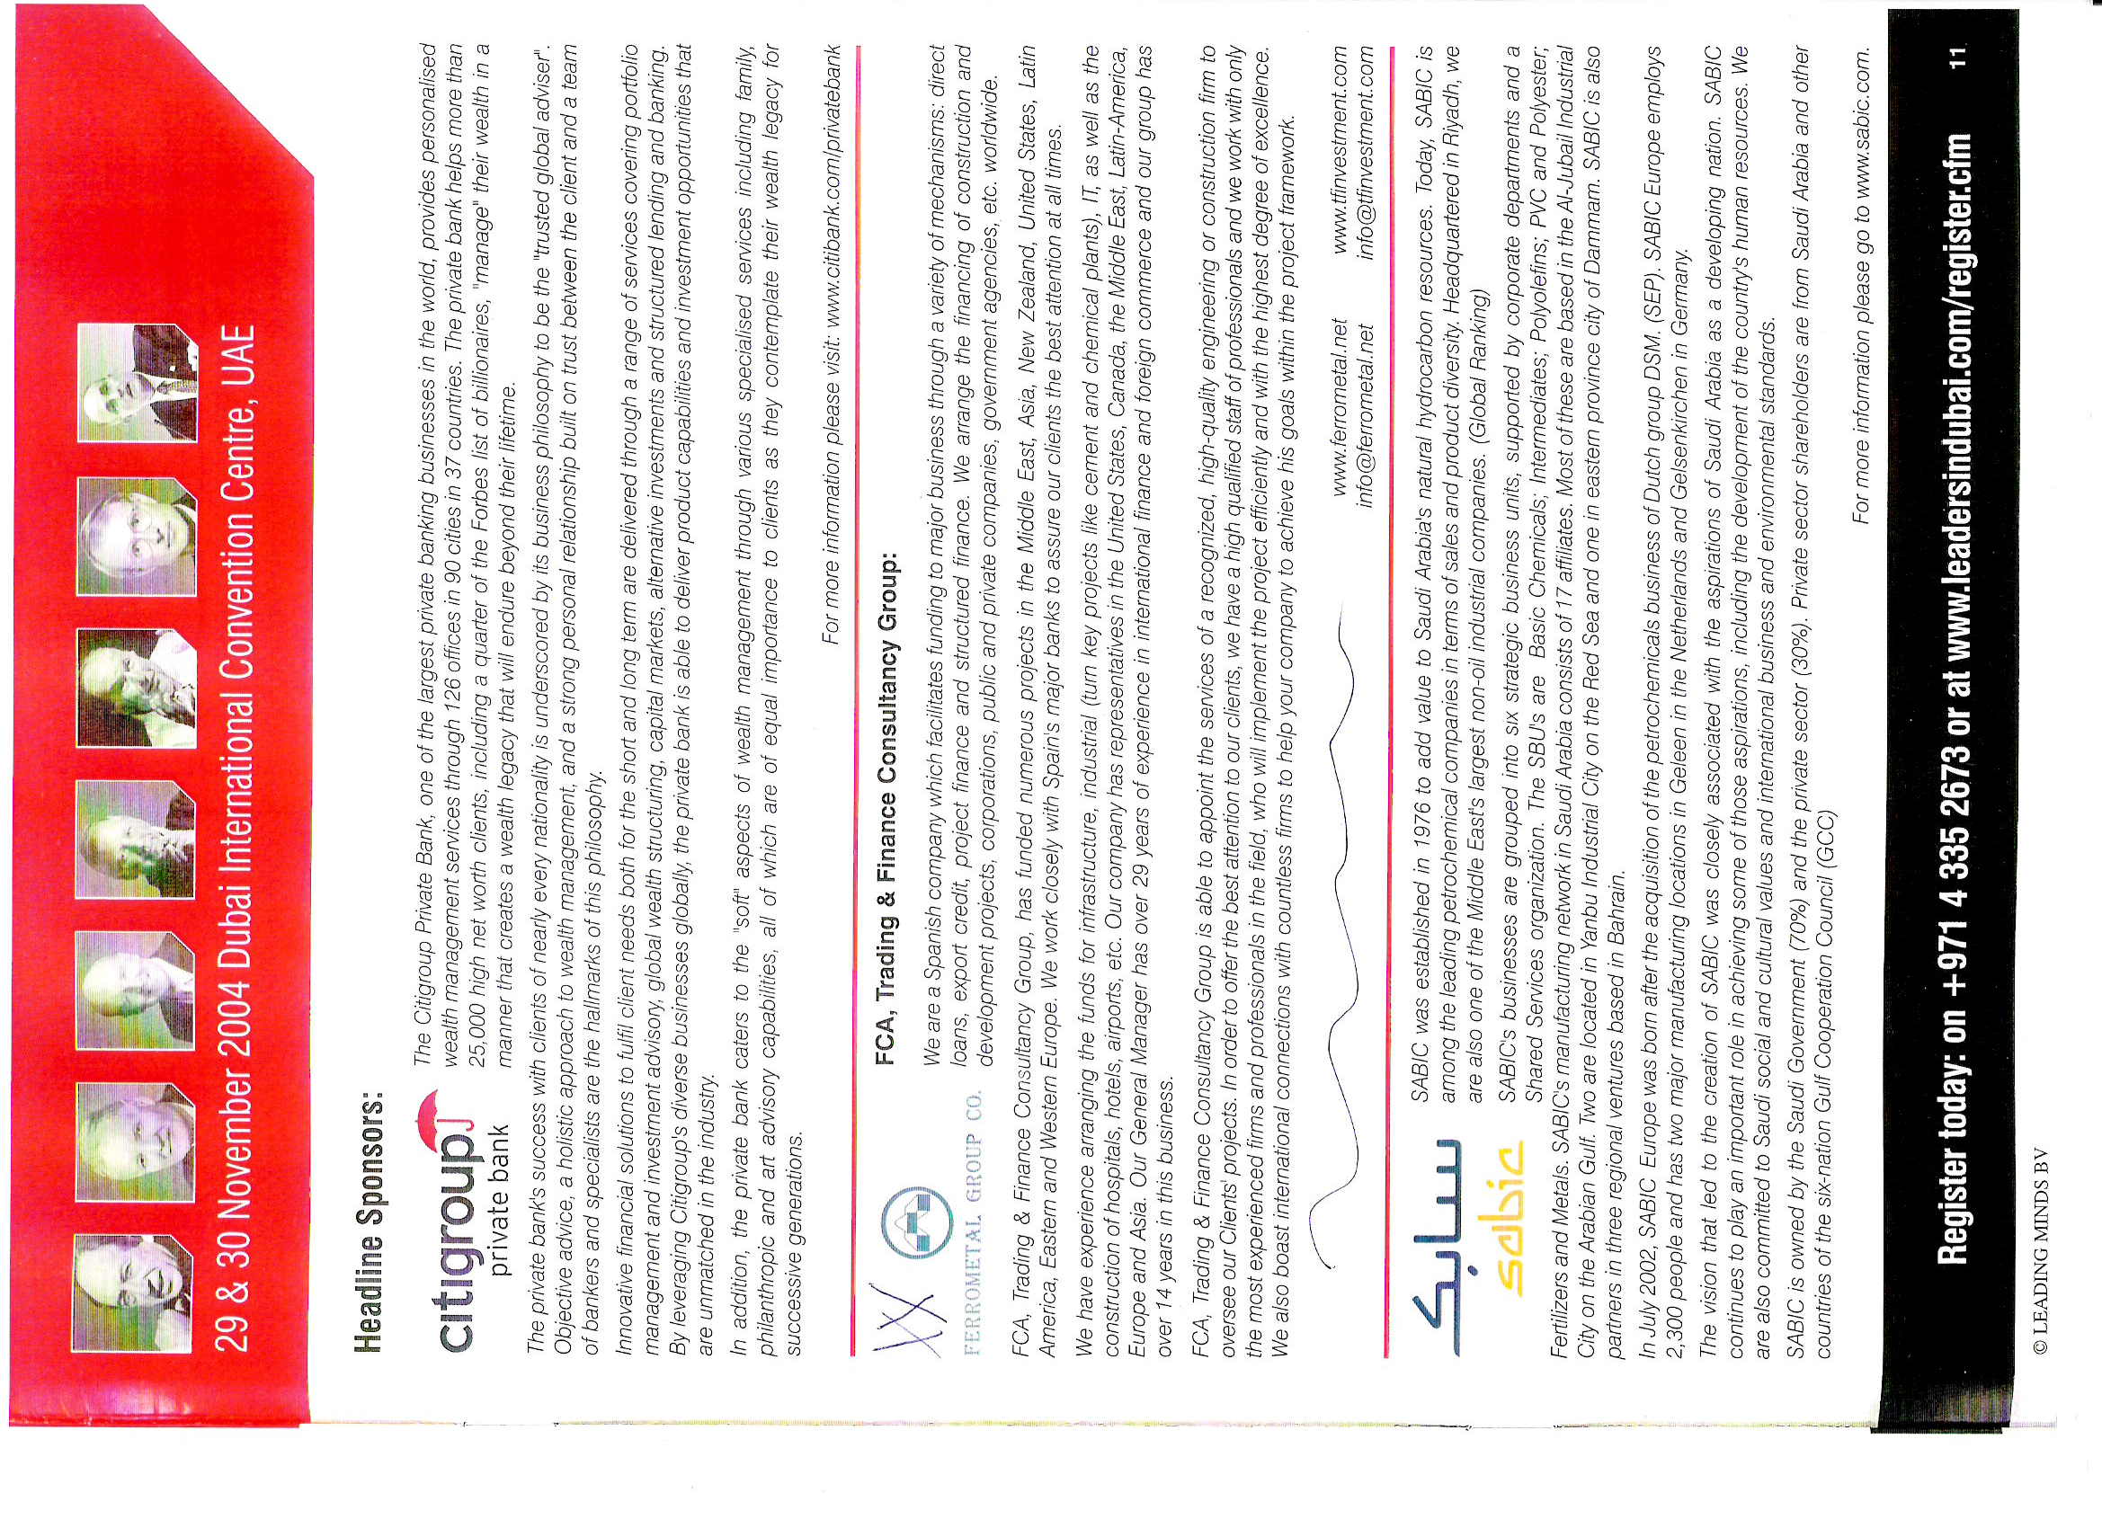

Slide 23
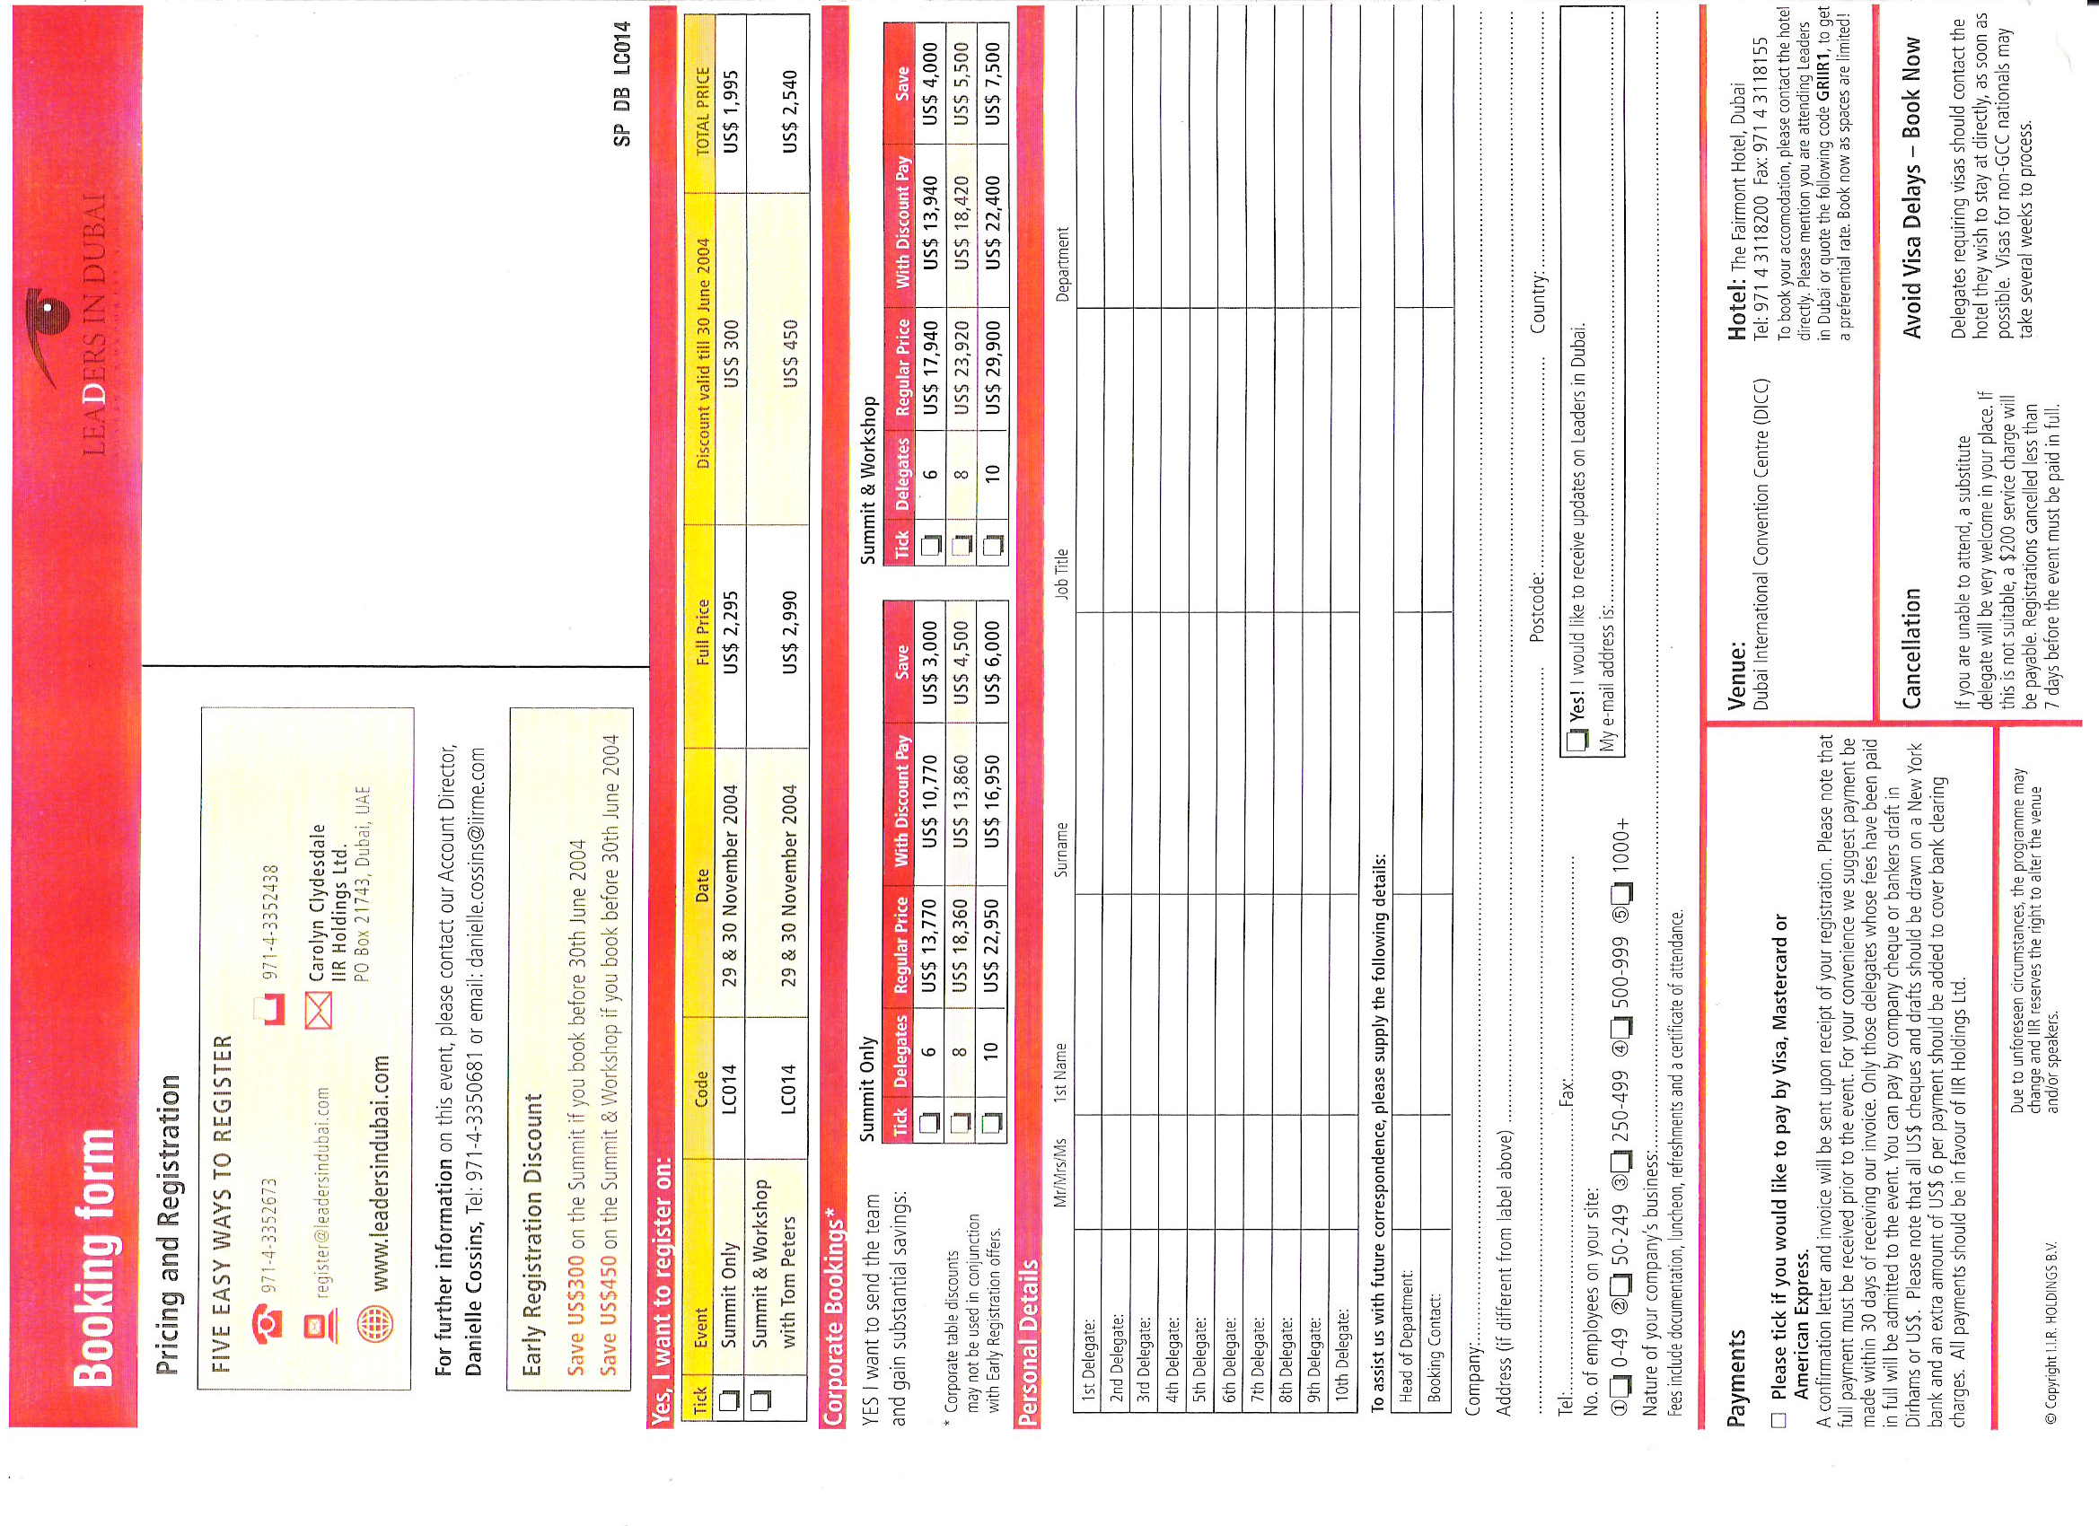

Slide 24
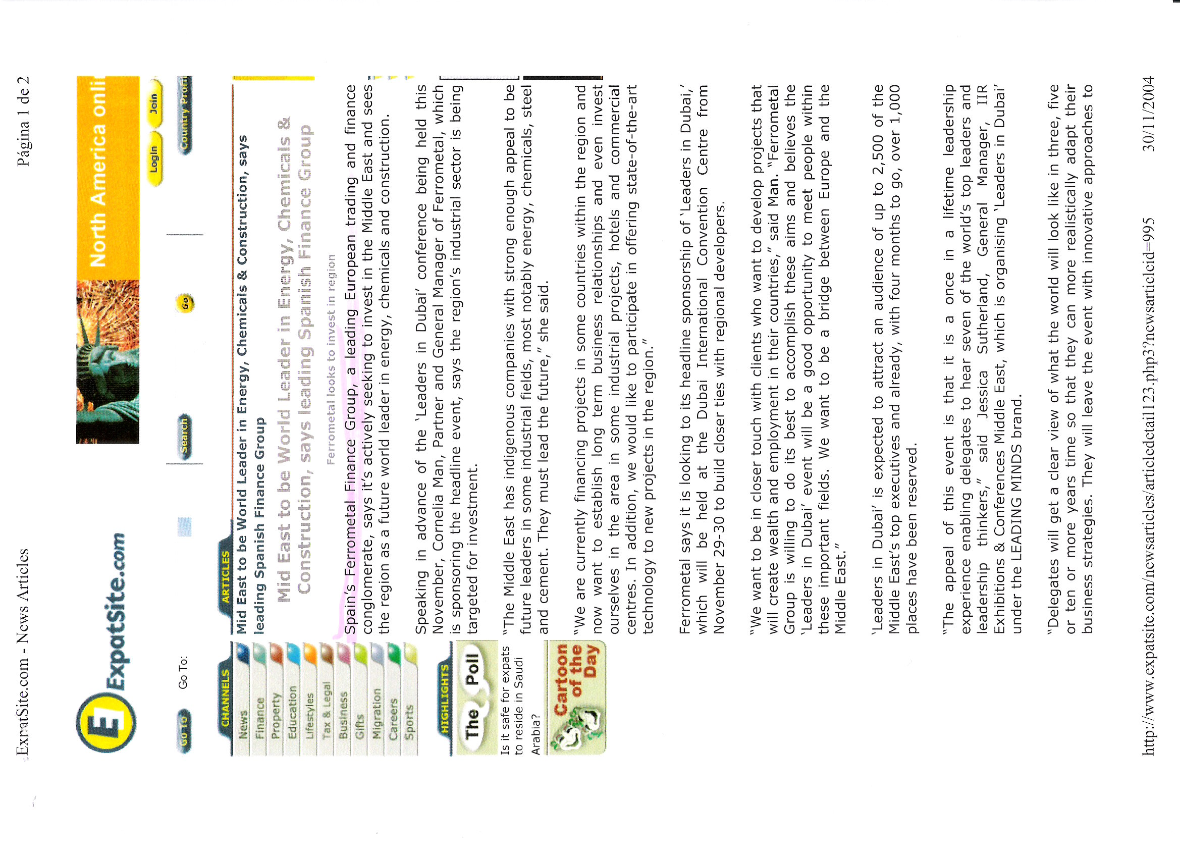

Slide 25
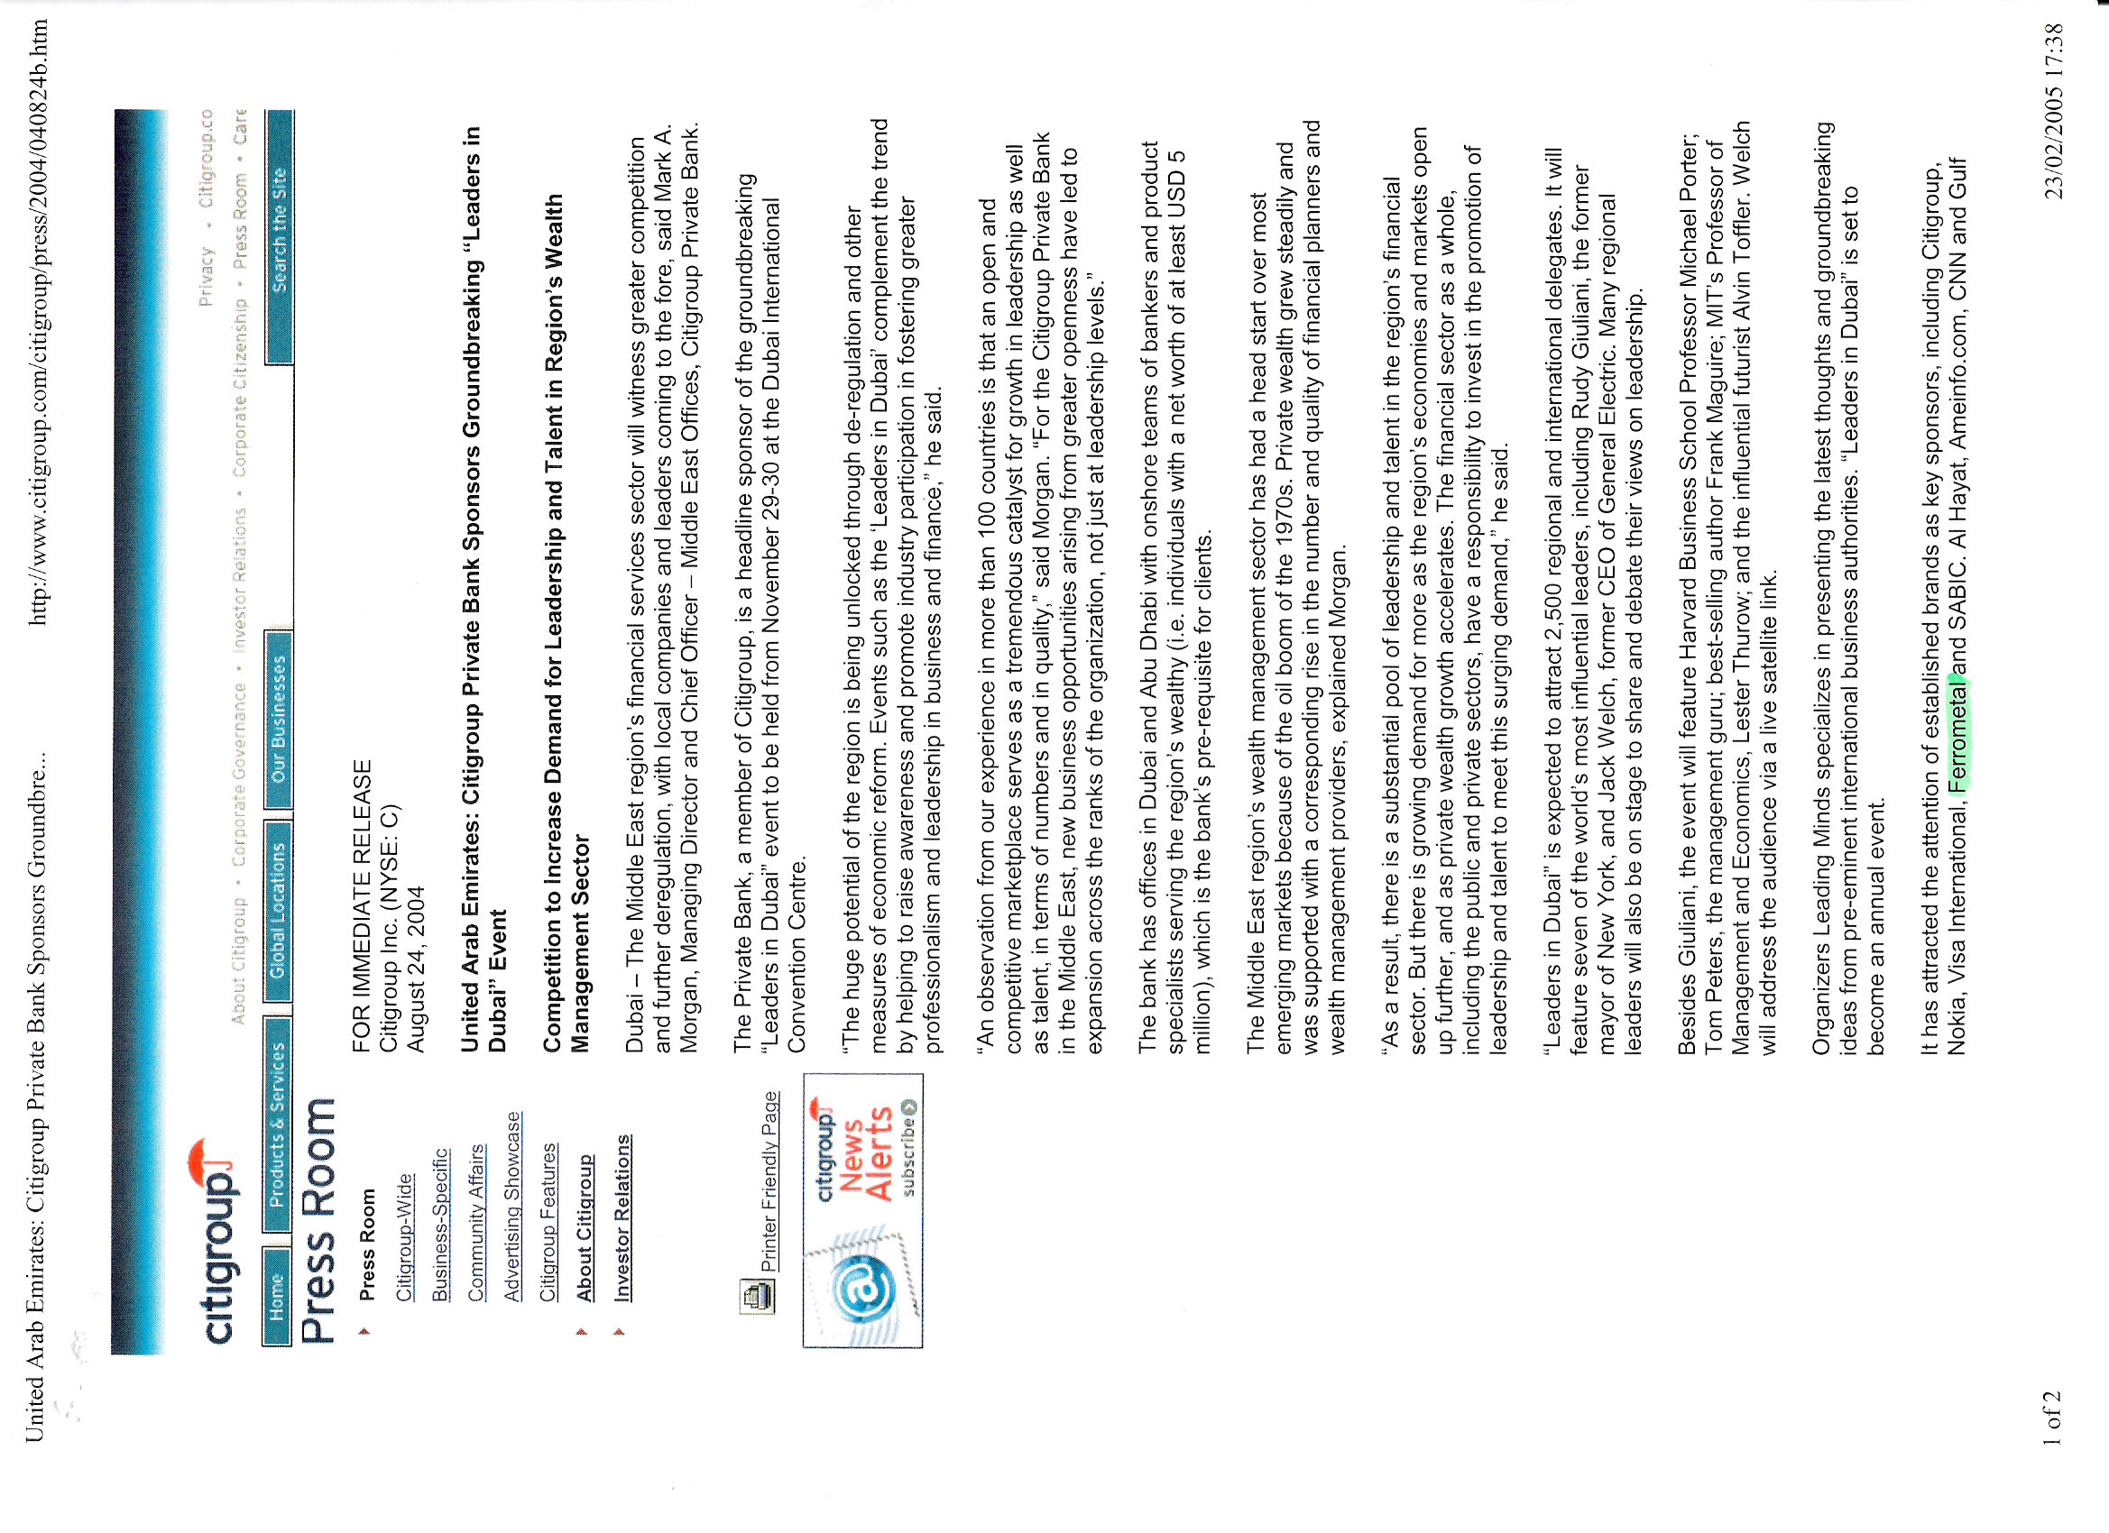
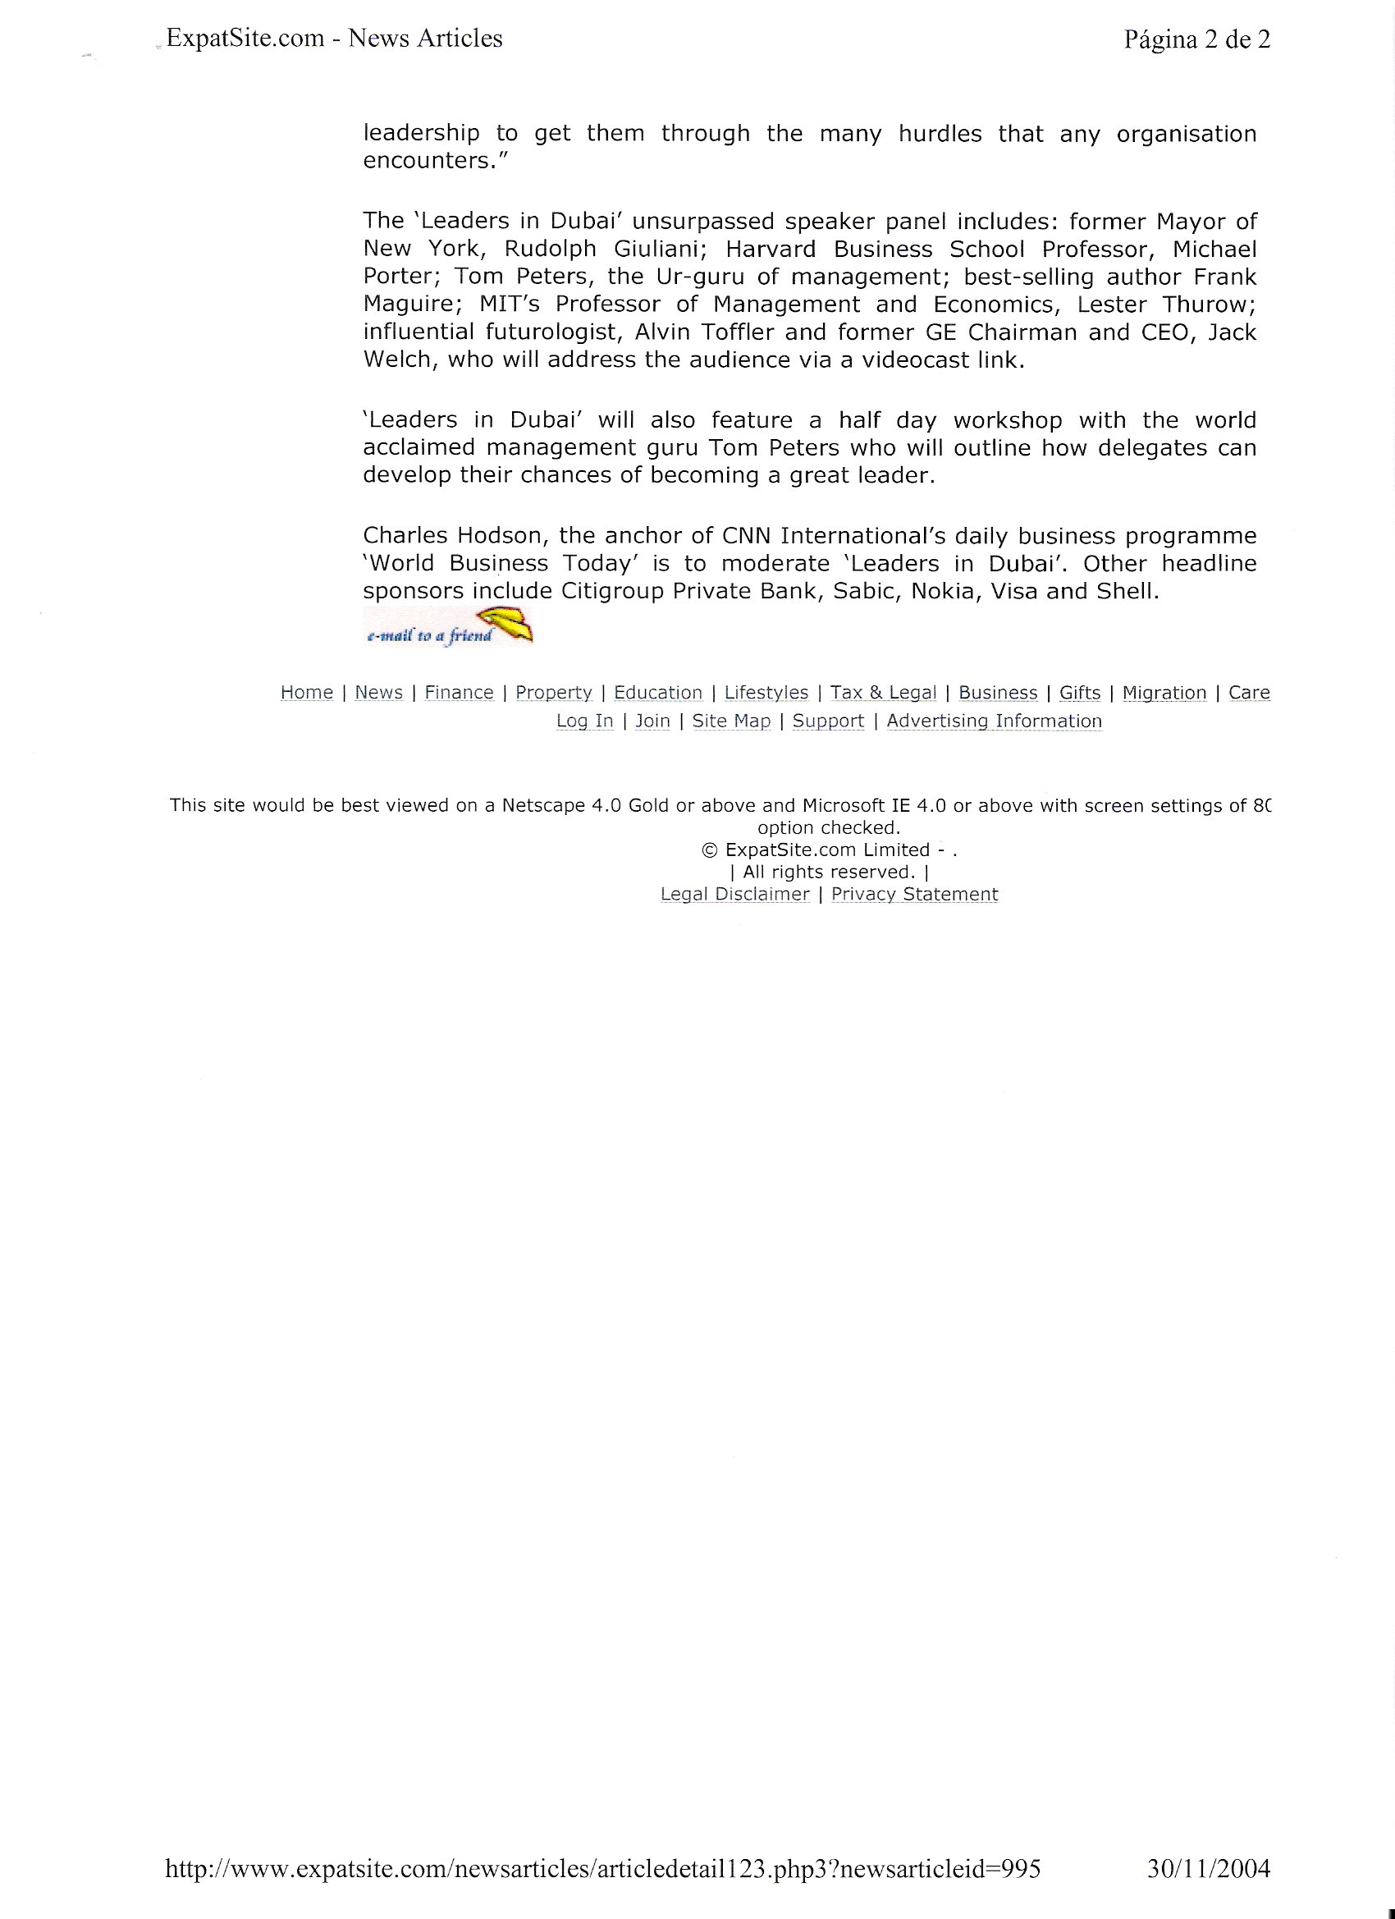

Slide 27
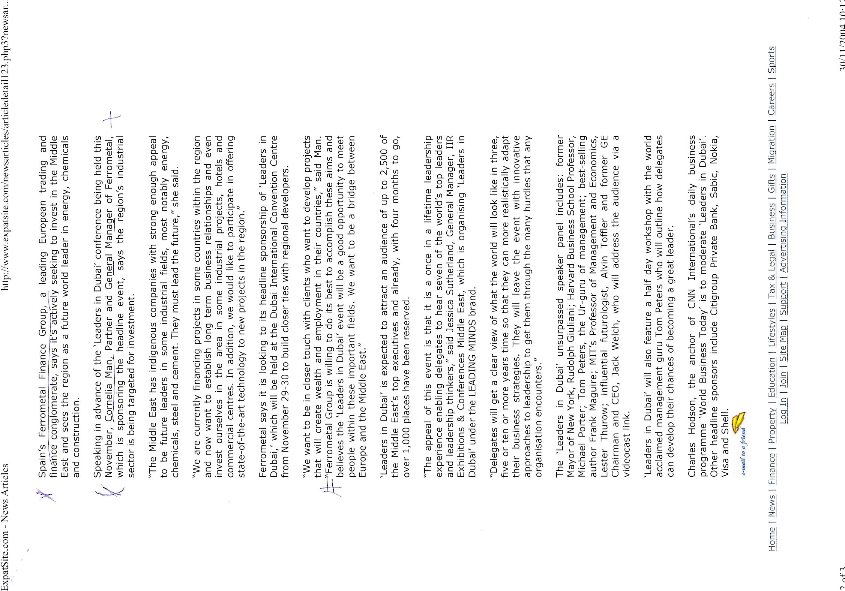

Slide 28
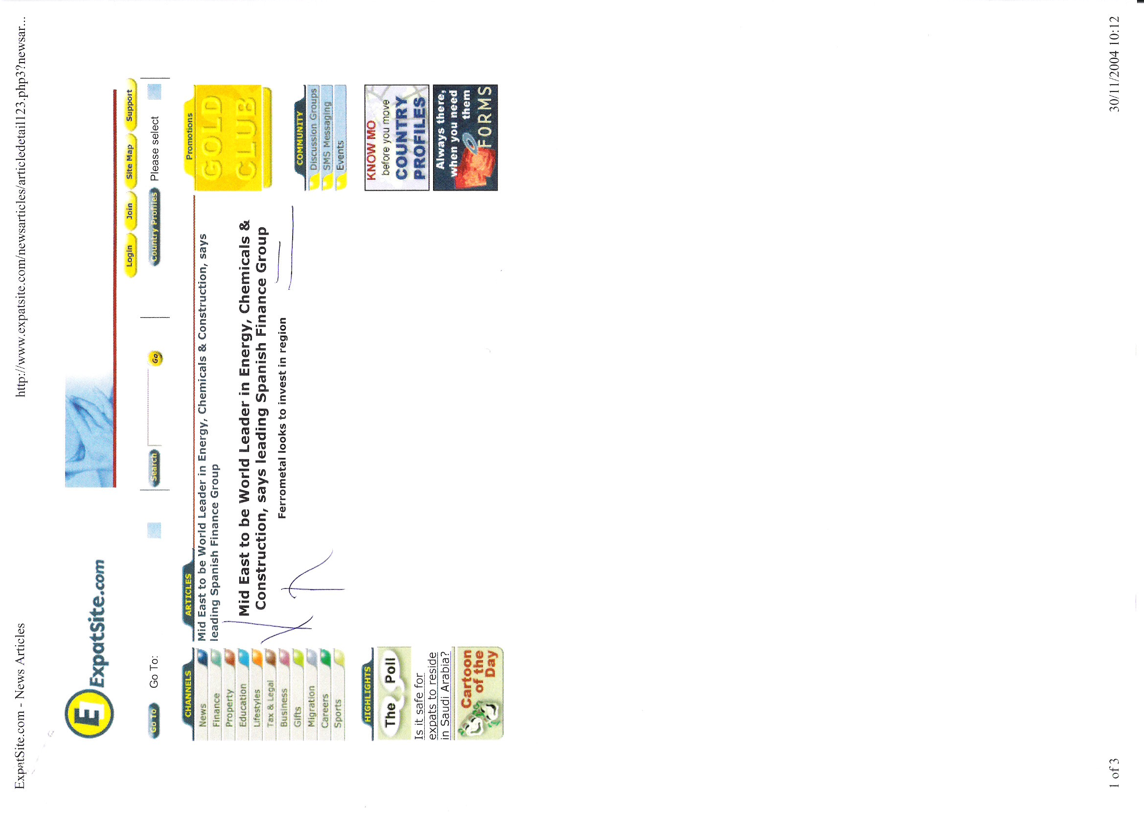

Slide 29
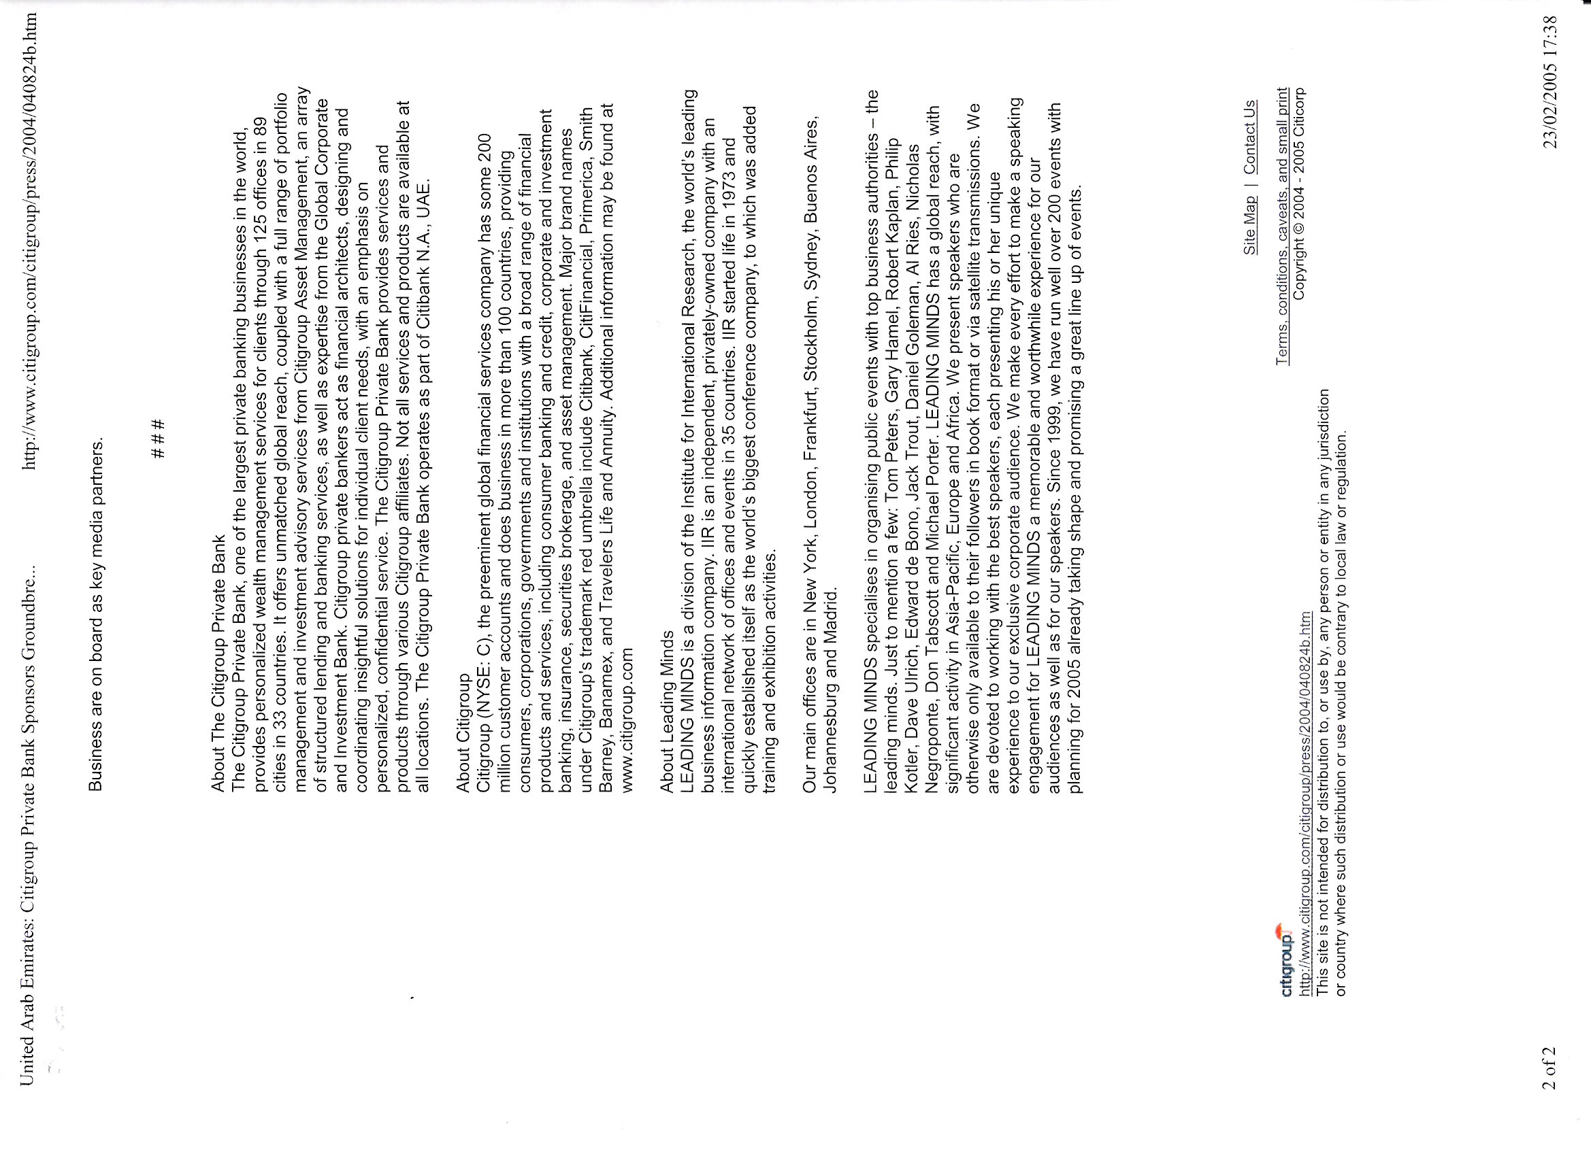

Slide 30
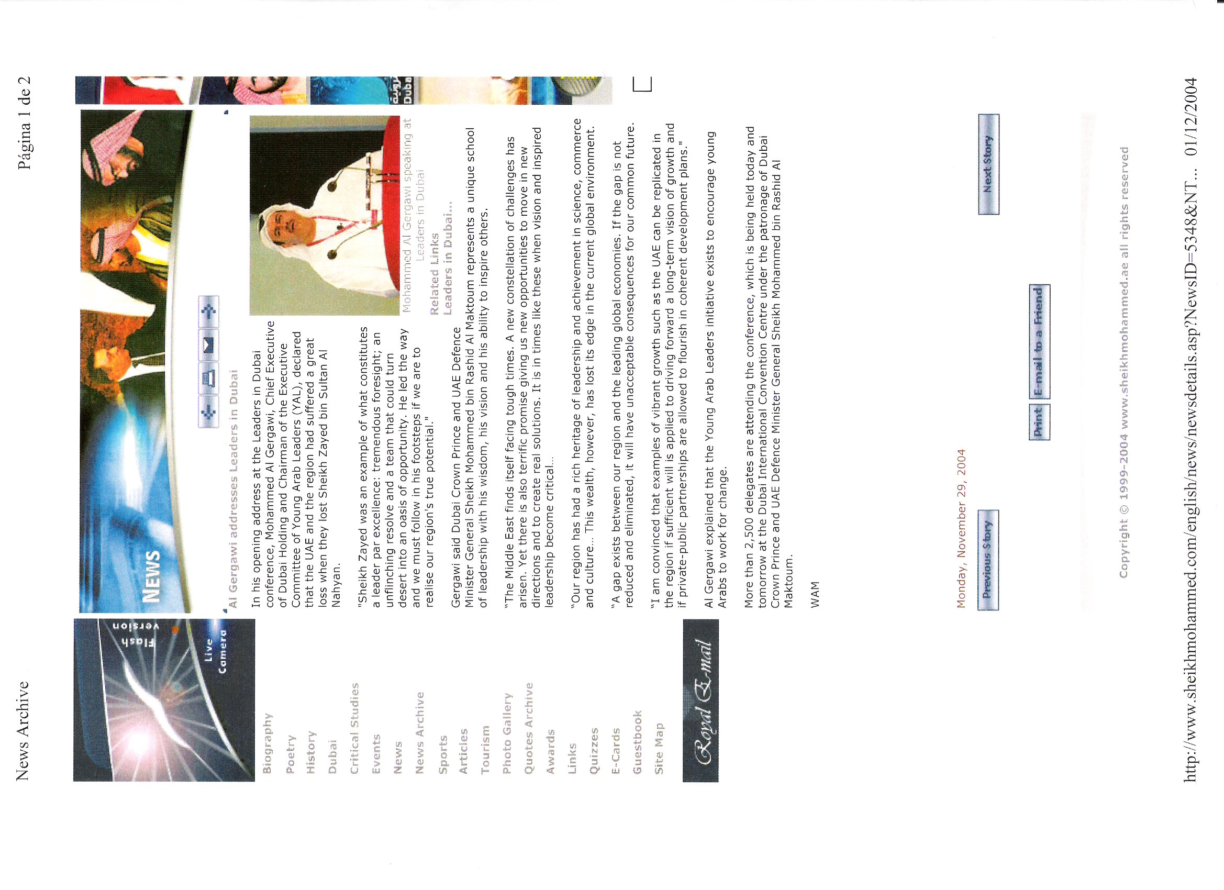

Slide 31
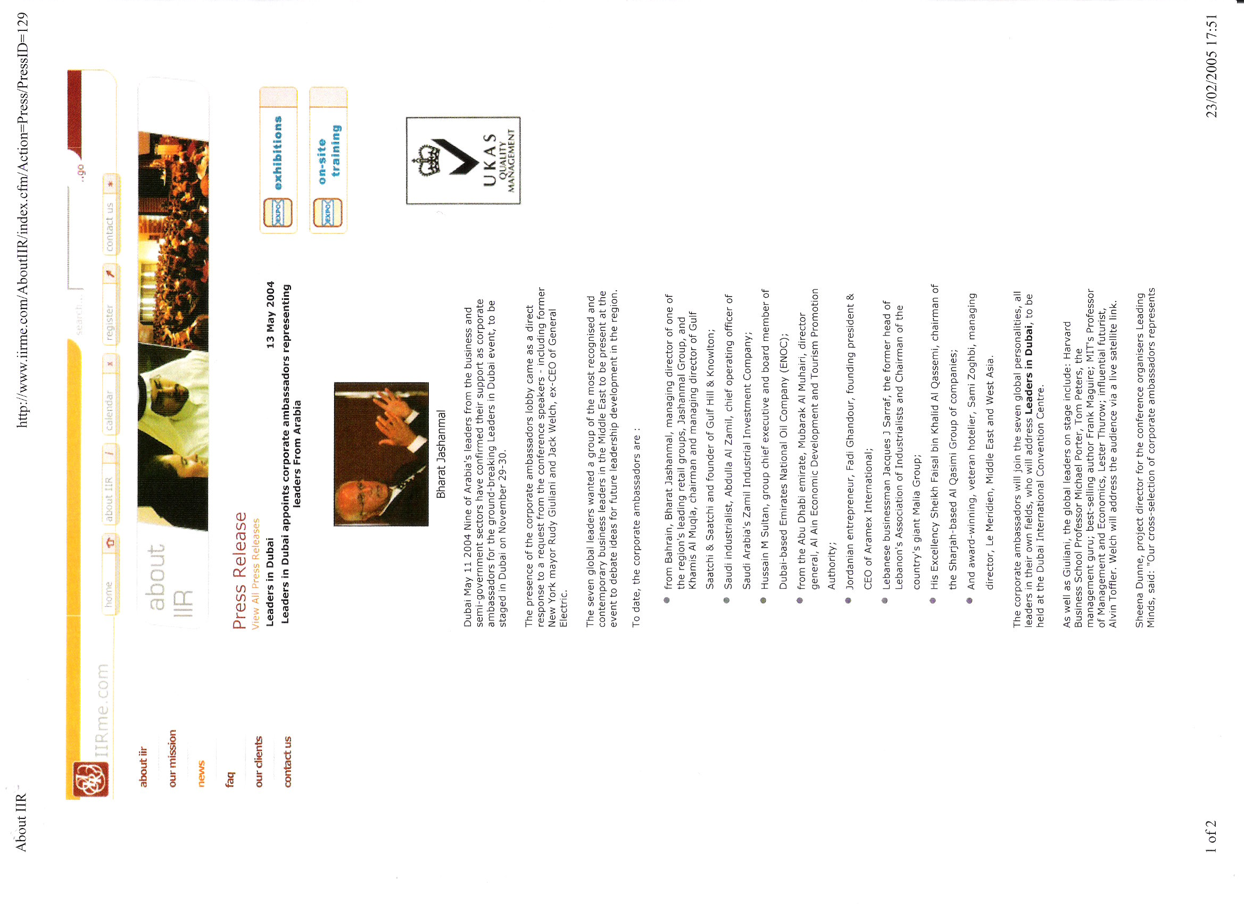

Slide 32
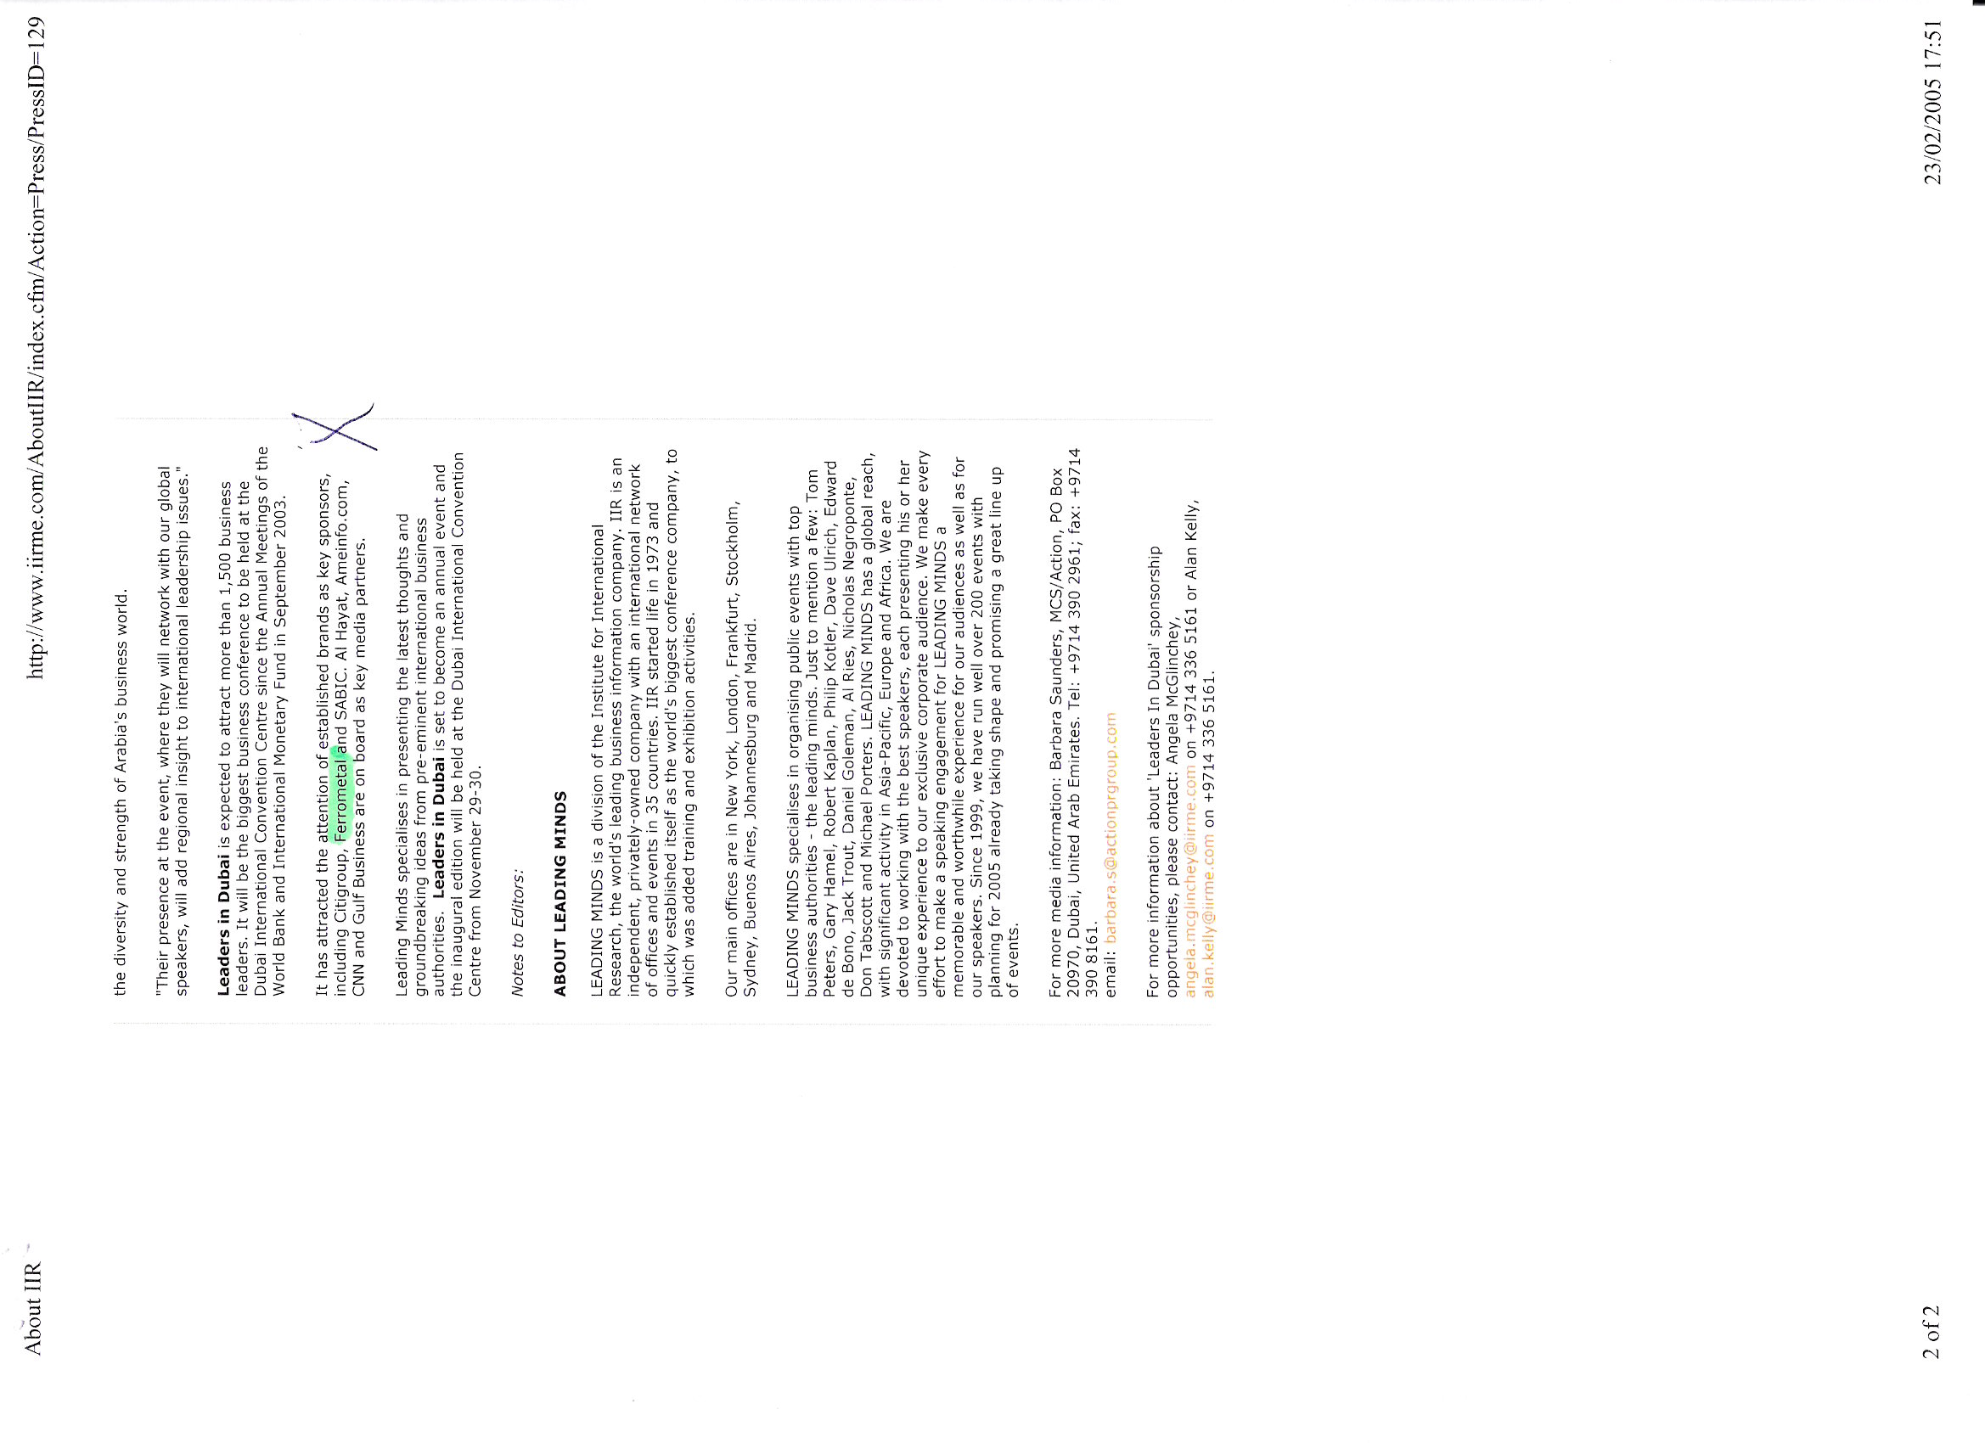

Slide 33
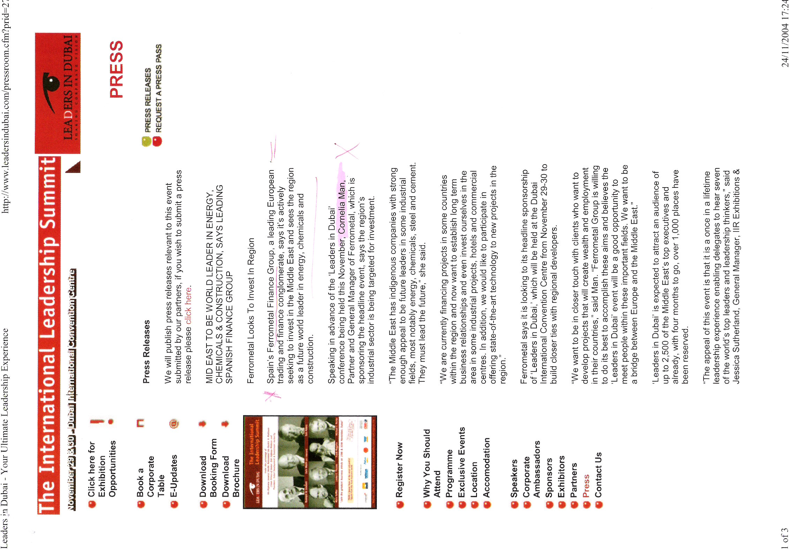

Slide 34
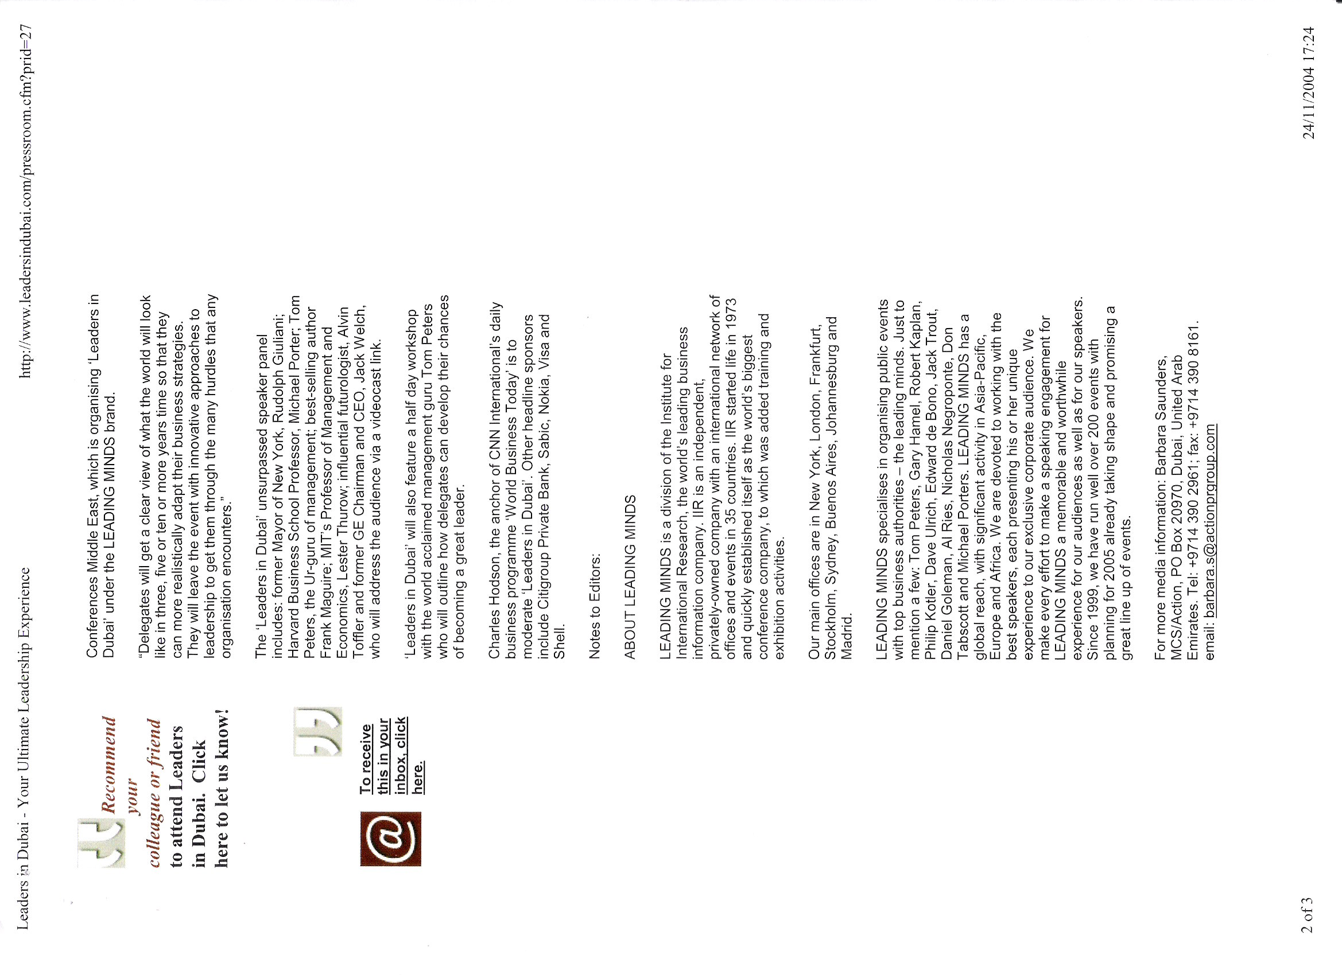

Slide 35
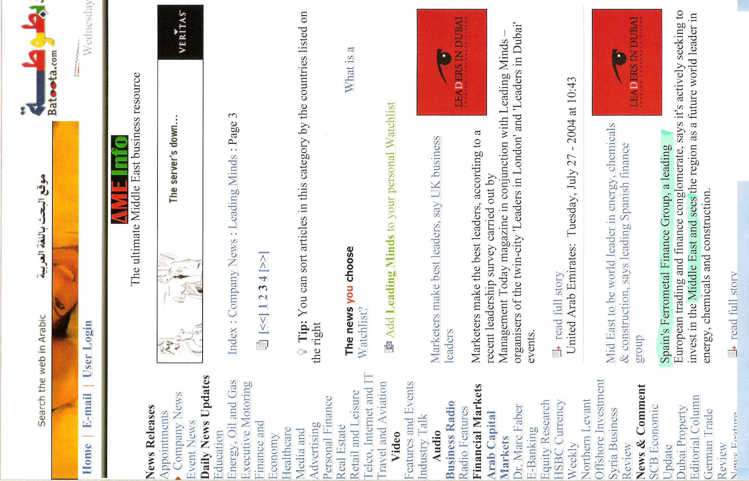

Slide 36
